Slide 1




Capstone Project
Hotel analysis

Slide 2
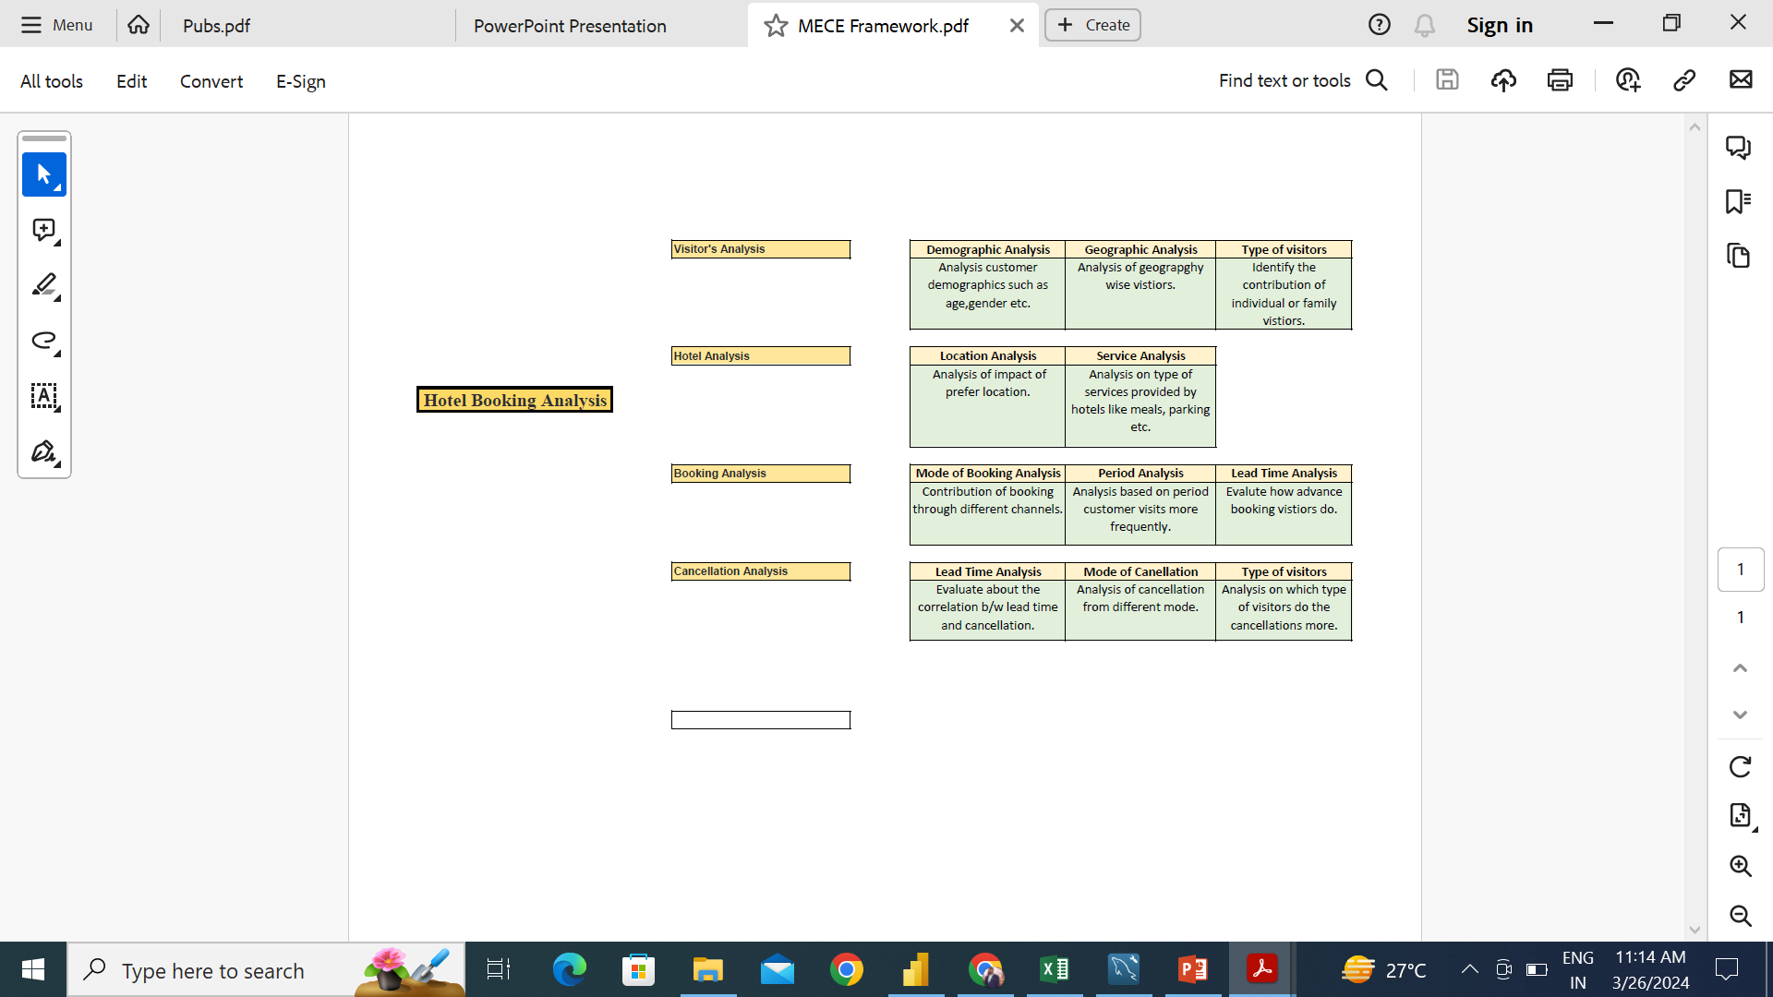
MECE FRAMEWORK

Slide 3
Analysis Scope: The analysis will focus on various aspects of the hotel booking process, including booking channel and guest’s age distribution, hotel performance, and the impact of meals and parking spaces. It will encompass historical booking data based on different hotel types, seasonality, and distribution data of multiple booking channel.
Objective: The objective of this project is to retrieve the data from Database and create visualizations utilizing the Hotel Booking Database. The visualizations aims to provide valuable insights into the hotel's performance, guest’s preference, booking and cancellation analysis, enabling data-driven decision-making and strategic planning.
Goal: The primary goal of this Project is to offer a holistic view of the Hotel's operations. It will provide actionable insights to optimize hotel booking, reduce cancellation ratio, improve strategies based on hotel types and seasons, and identify opportunities for growth and efficiency.

Slide 4
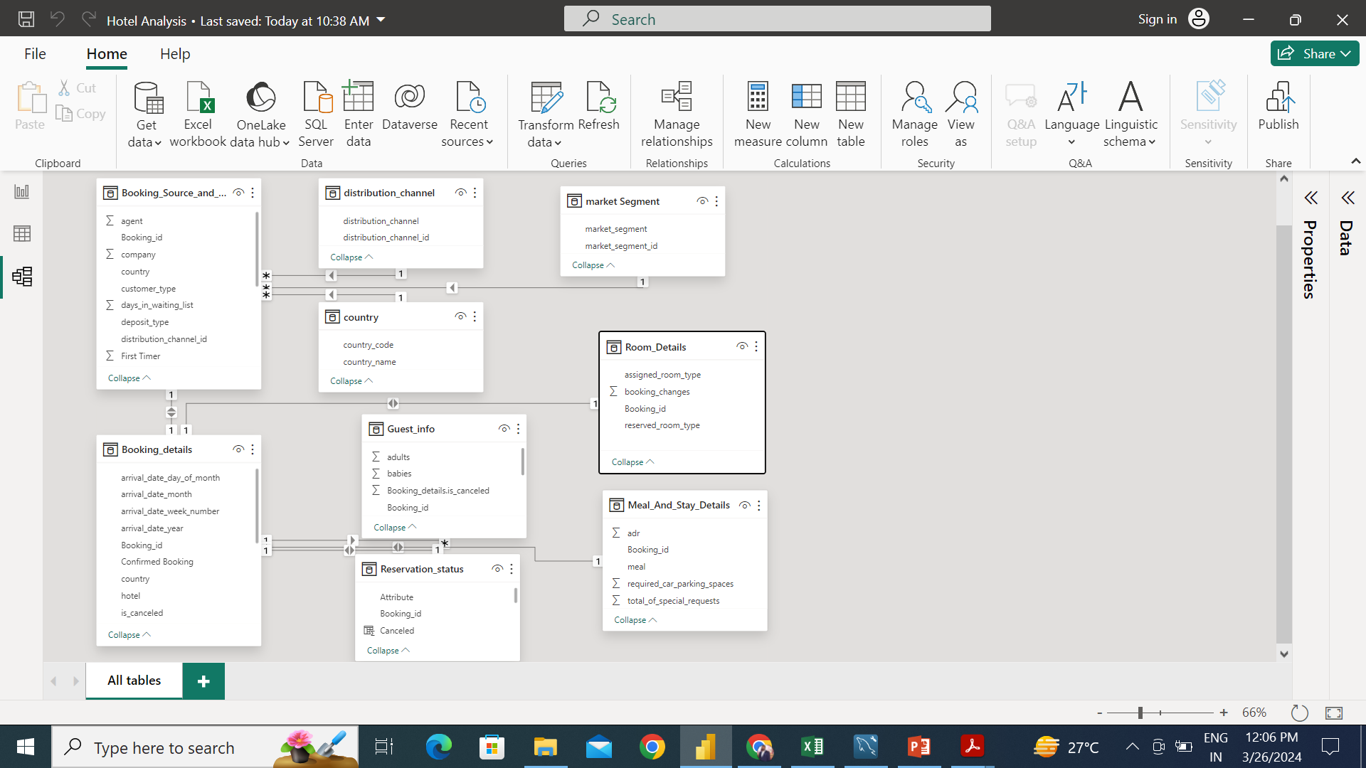
ER Diagram

Slide 5
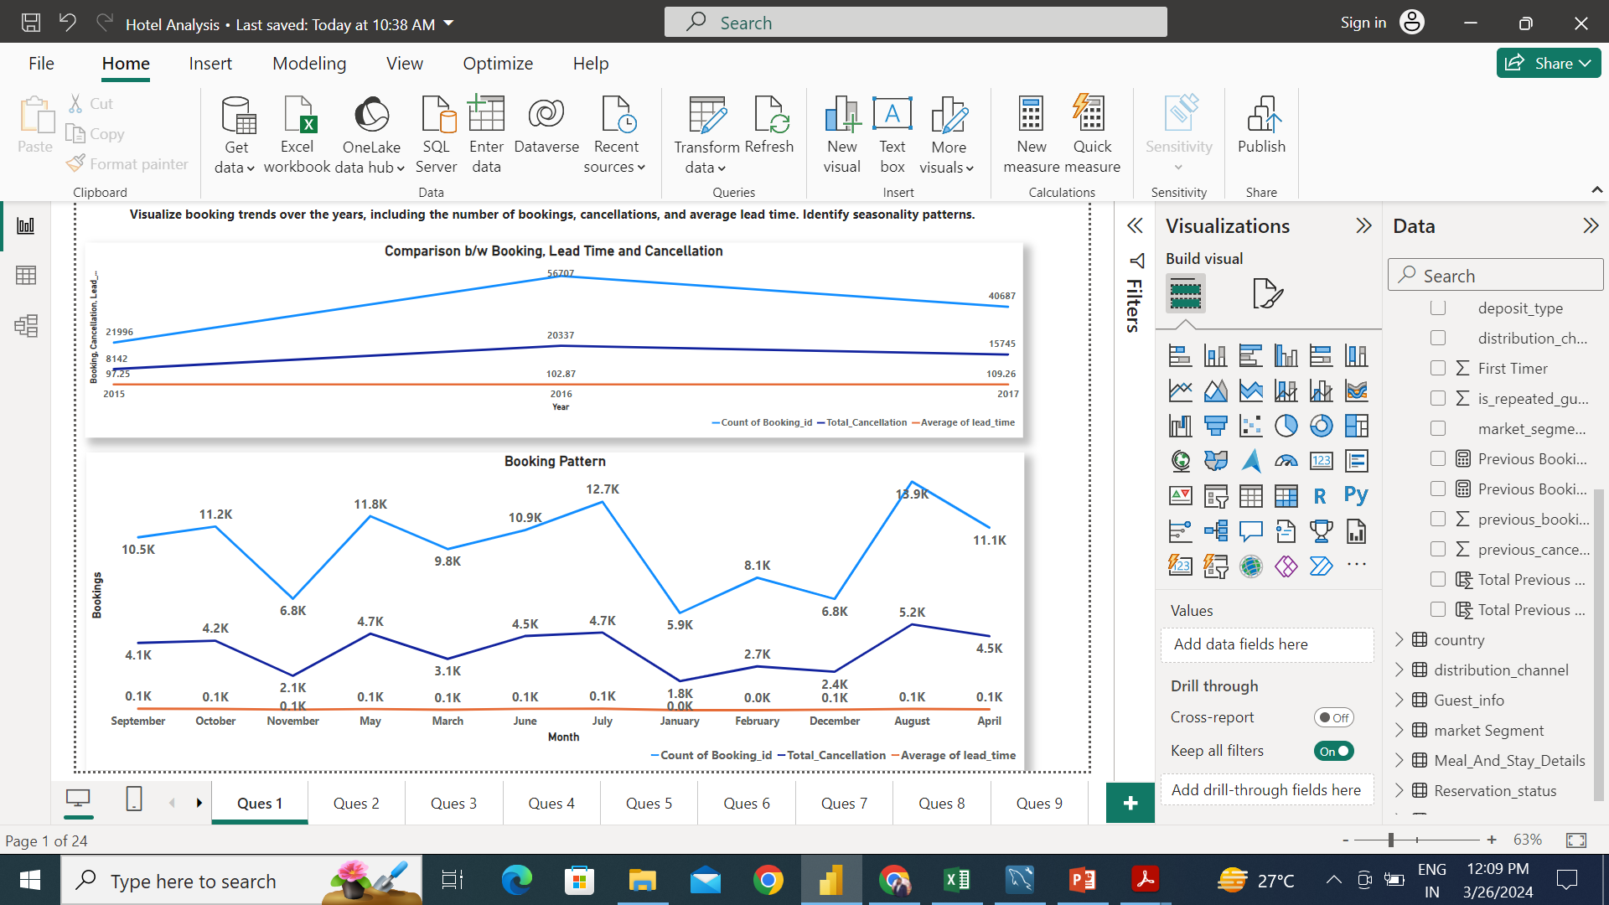
We can see that 2016 is best year in term of bookings. As 2016 has most number of bookings so as highest numbers in term of cancellation as well.
July, August and September has the most bookings.

Slide 6
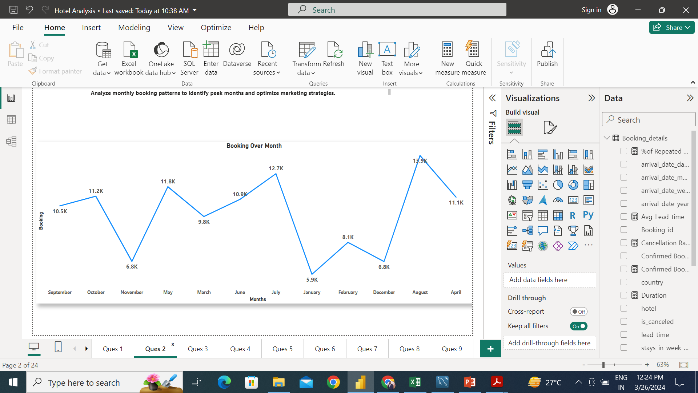
July, August and September are the best months in terms of bookings. We can make focus and make strategies to capitalize these months and make these number even better.

Slide 7
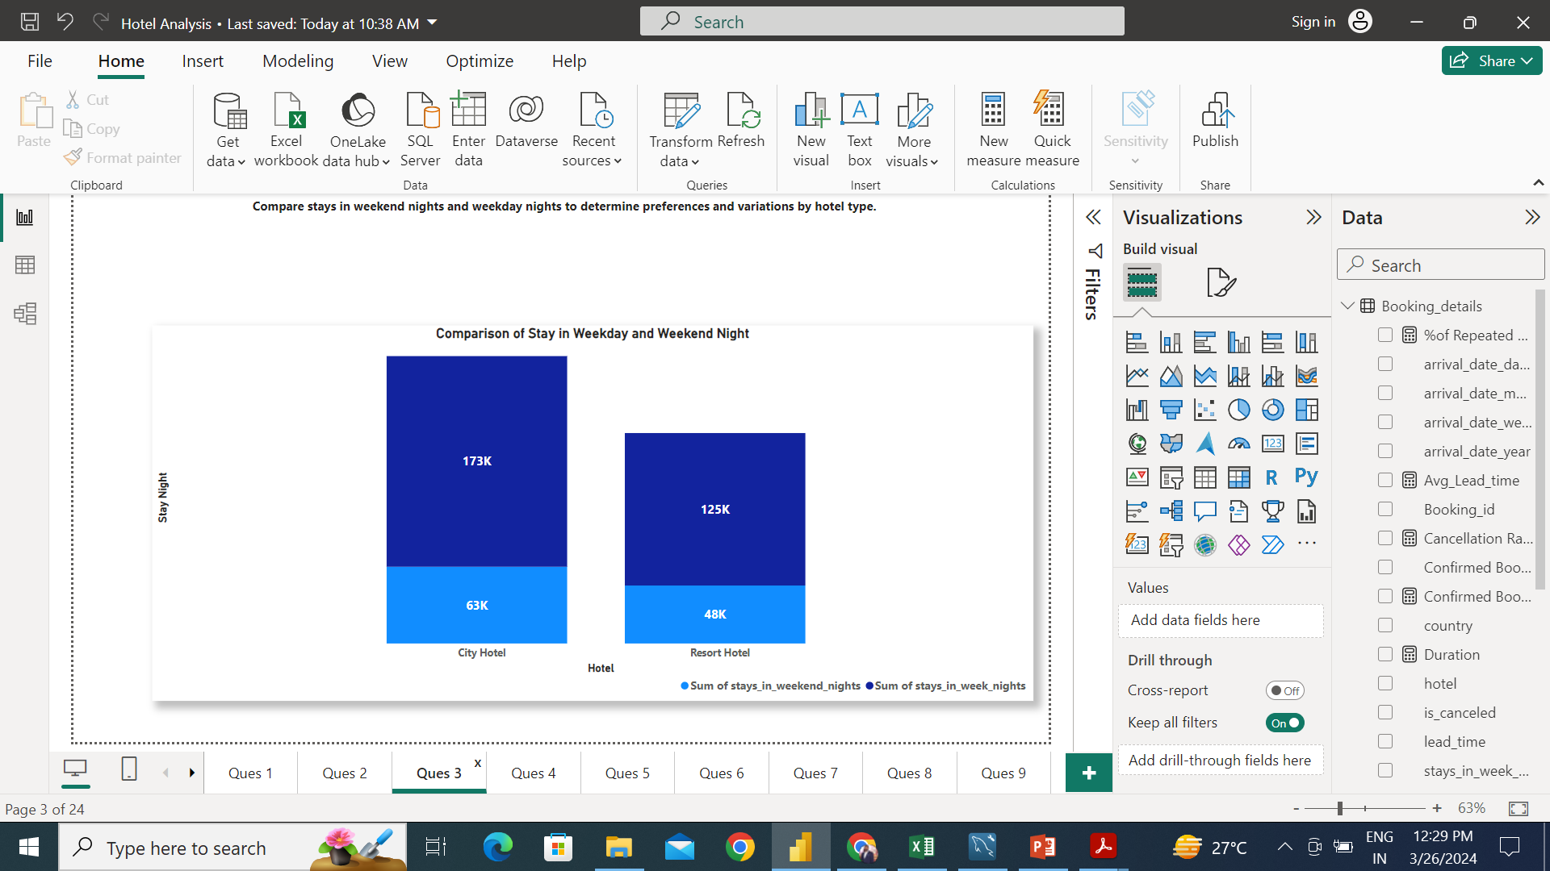
Guest prefer Weekends night to stay in both hotel type. So, we can increase ADR and also can increase temporary staff during weekend nights, so we can give good experience to the customer and also the margins.

Slide 8
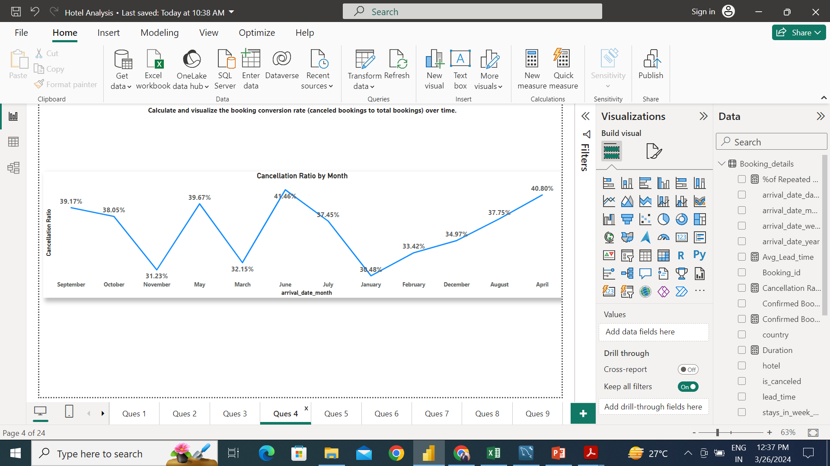
April, May and June has the worst conversion rate with highest cancellation rate among all months.

Slide 9
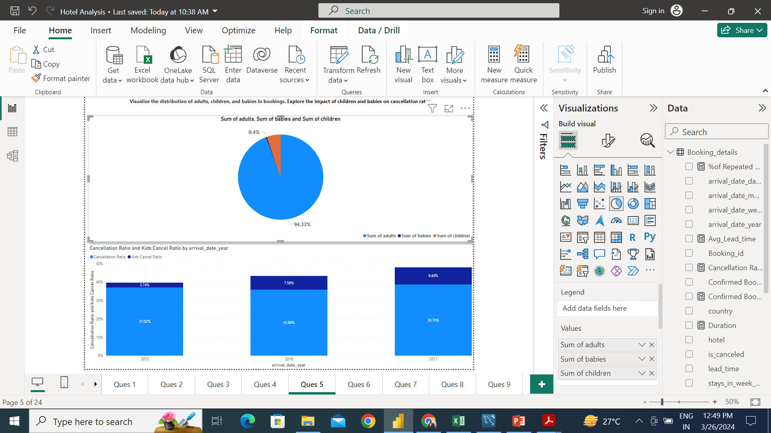
Adults has the maximum percentage among the guests. Cancellation ratio with children and babies has increasing over the years.

Slide 10
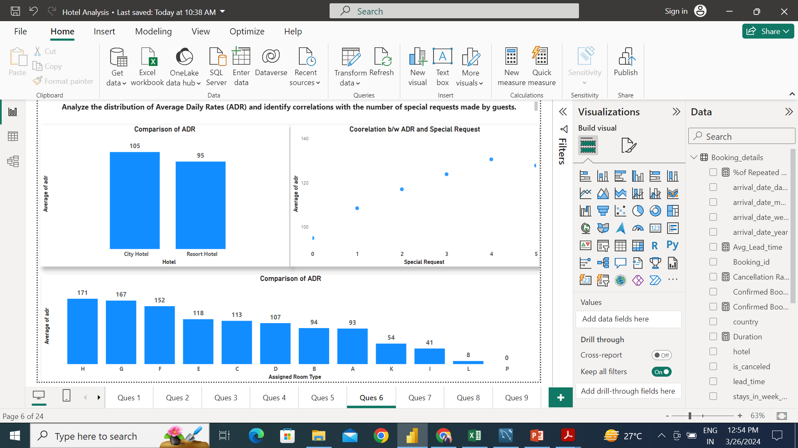
City has more ADR. H room type has the best ADR. As the number of special request has made, ADR has also increase. We can say special request and ADR has positive correlation.

Slide 11
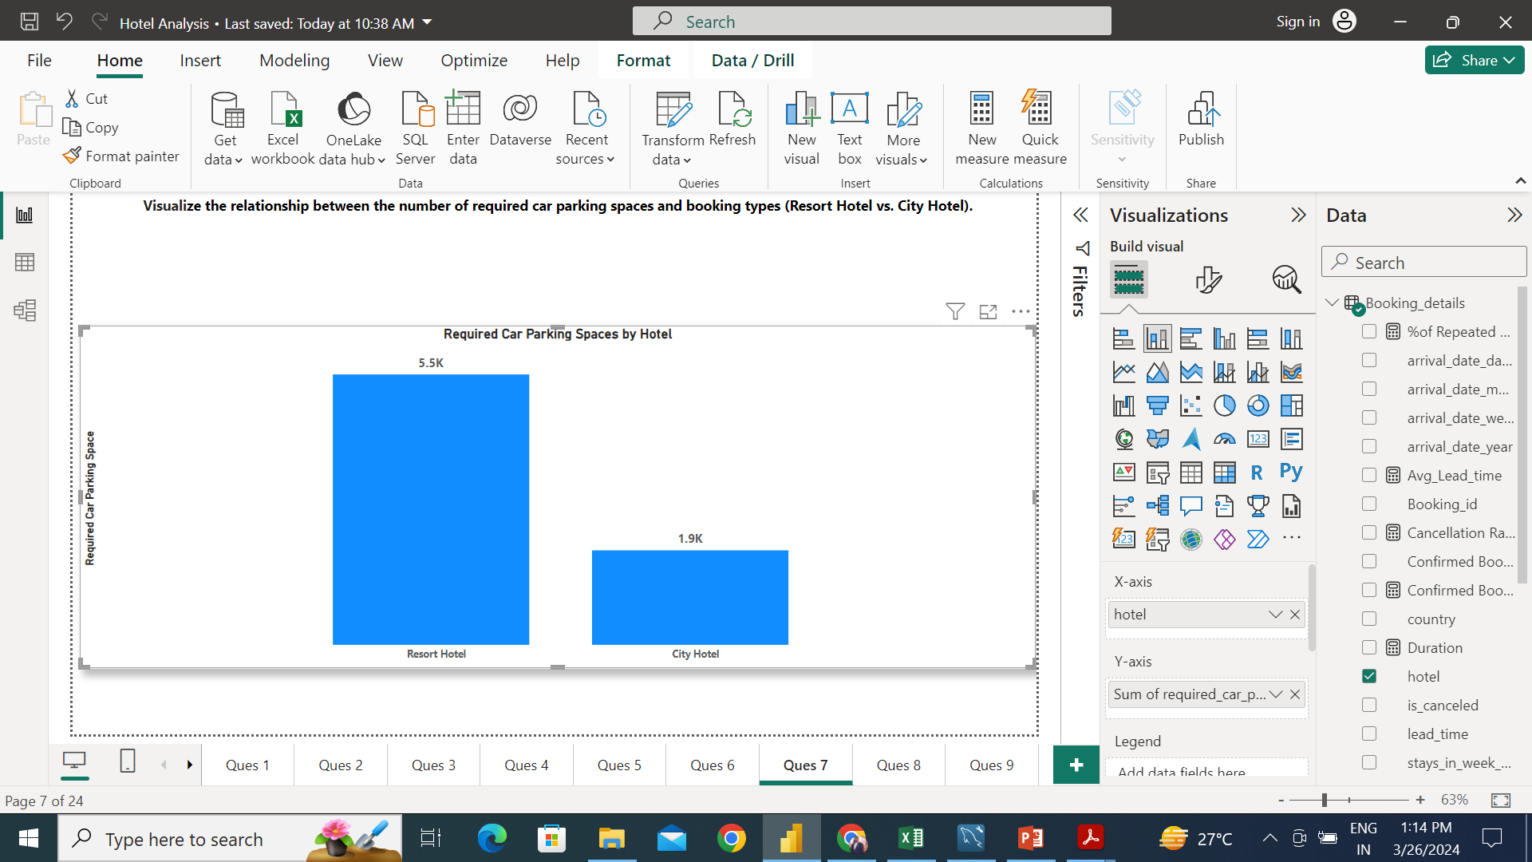
Resort hotel has required more number of parkings.

Slide 12
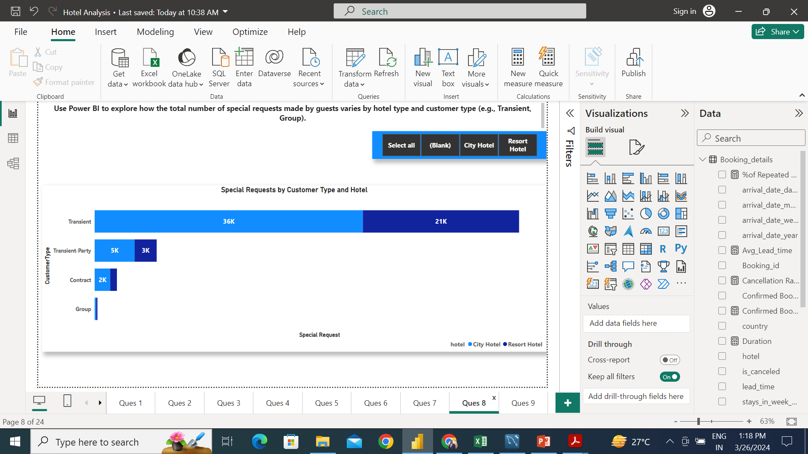
Transient customer type in City hotel has made most number of special request.

Slide 13
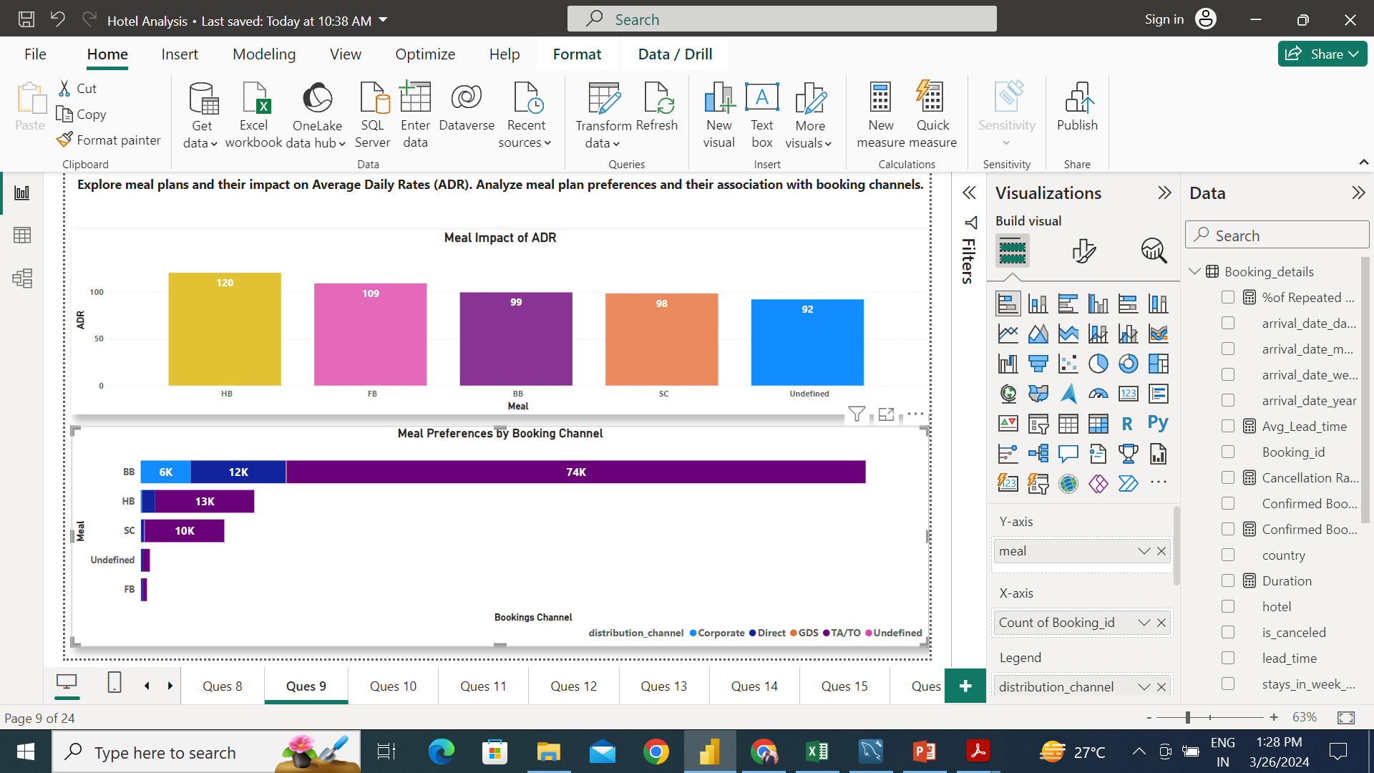
With HB meal plan ADR is the highest. TA/TO booking channel prefer the BB meal.

Slide 14
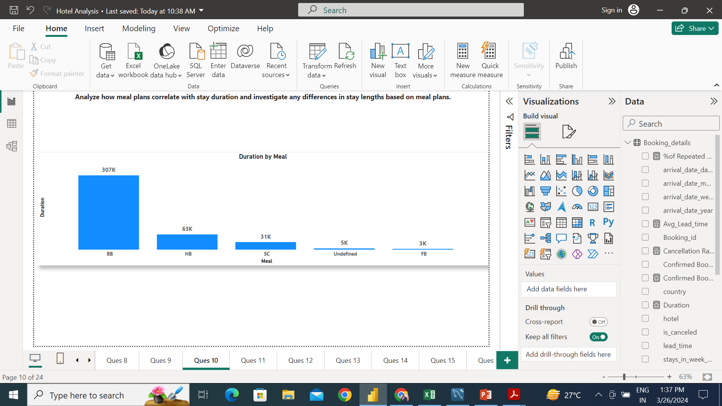
With BB meal plan, guest stayed long in term of duration.

Slide 15
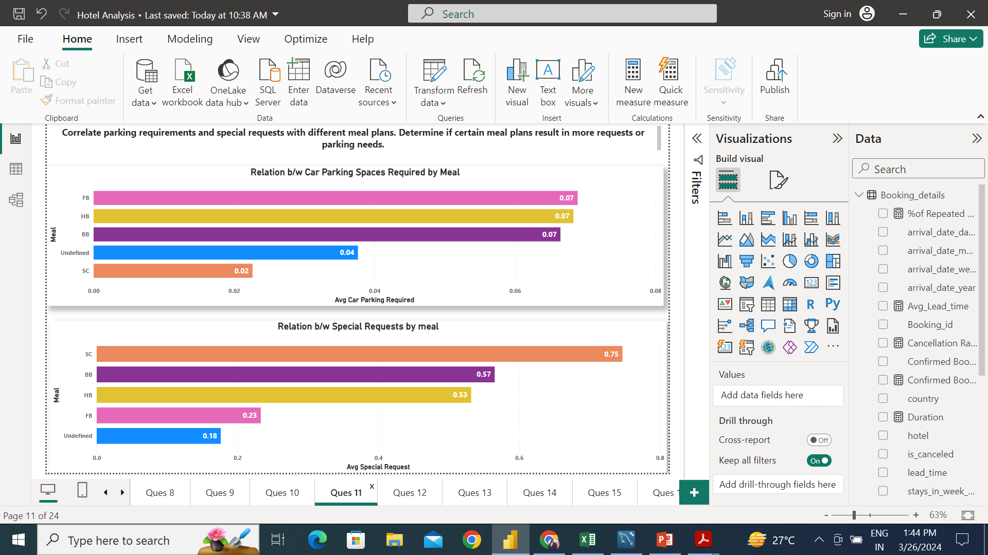
FB meal plan has most number of avg parking required but has 2nd lowest avg special requests made. On the other hand HB has 2nd most parking spaces required and has 2nd most special request made. So. There is no correlation b/w them.

Slide 16
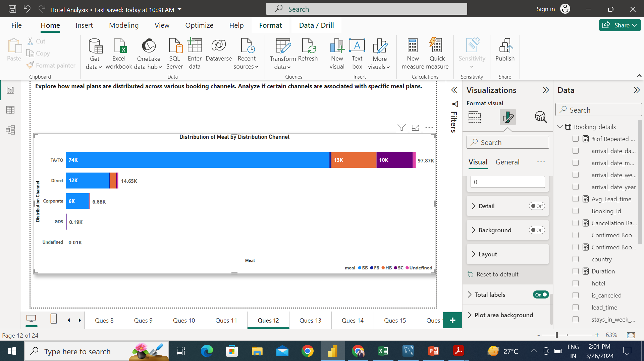
Corporate booking channel stick with BB meal plan most frequently.

Slide 17
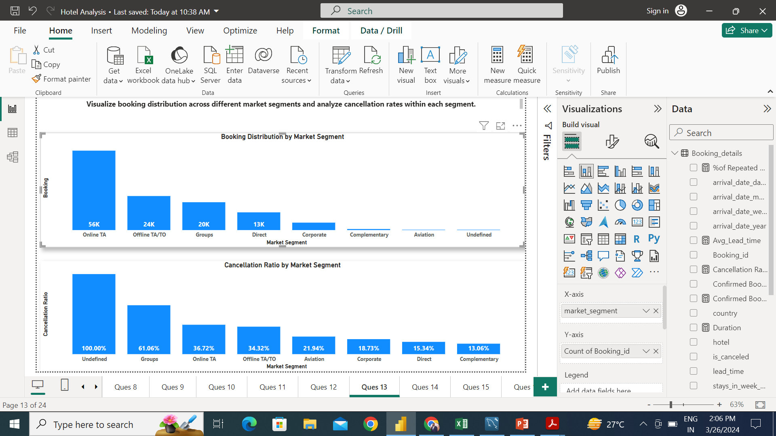
Online TA has the most number of bookings and also has decent cancellation ration among all segment.

Slide 18
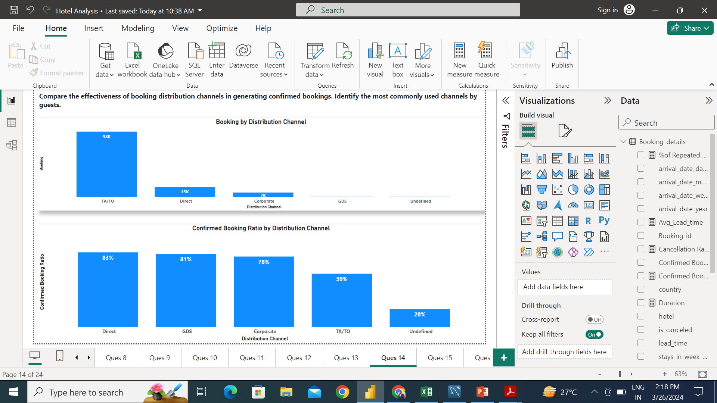
TA/TO is the highest number among distribution channel to generate bookings but Direct distribution has the best confirmed booking ratio, followed by GDS and Corporate.

Slide 19
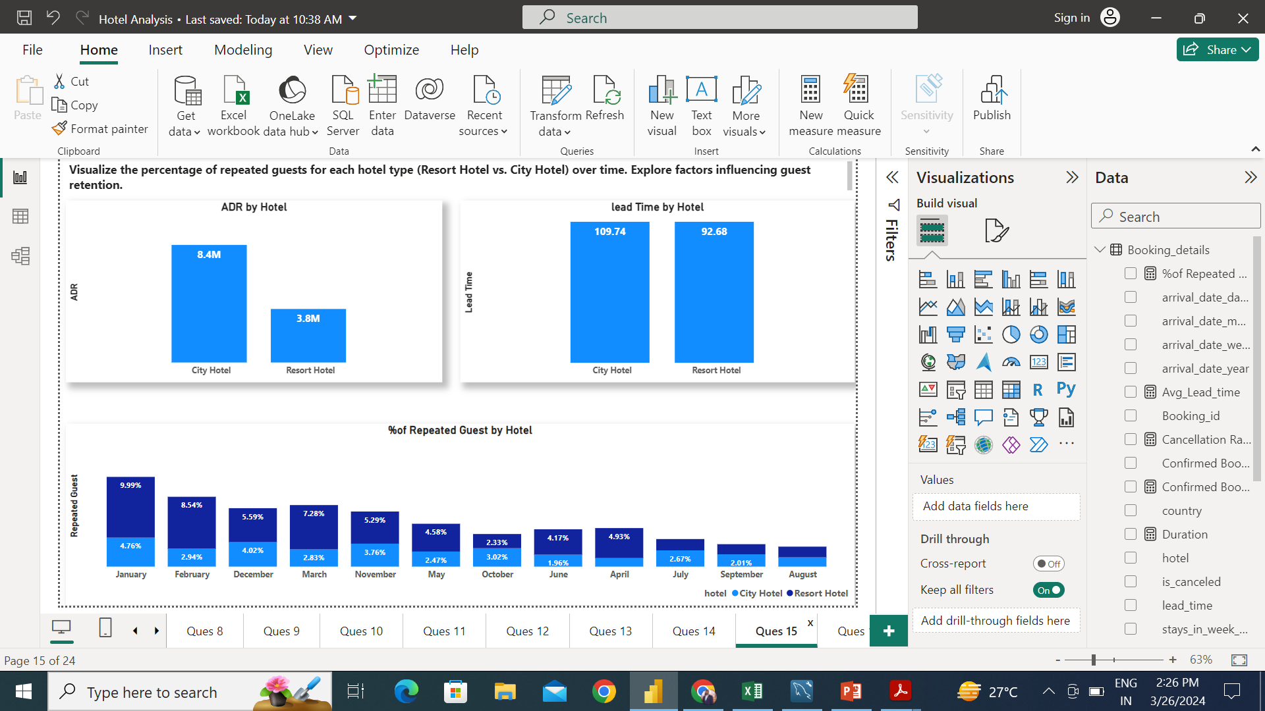
Resort hotel type has the better retention rate. We can see Resort has lower ADR and Lead time that maybe the reason for better retention rate.

Slide 20
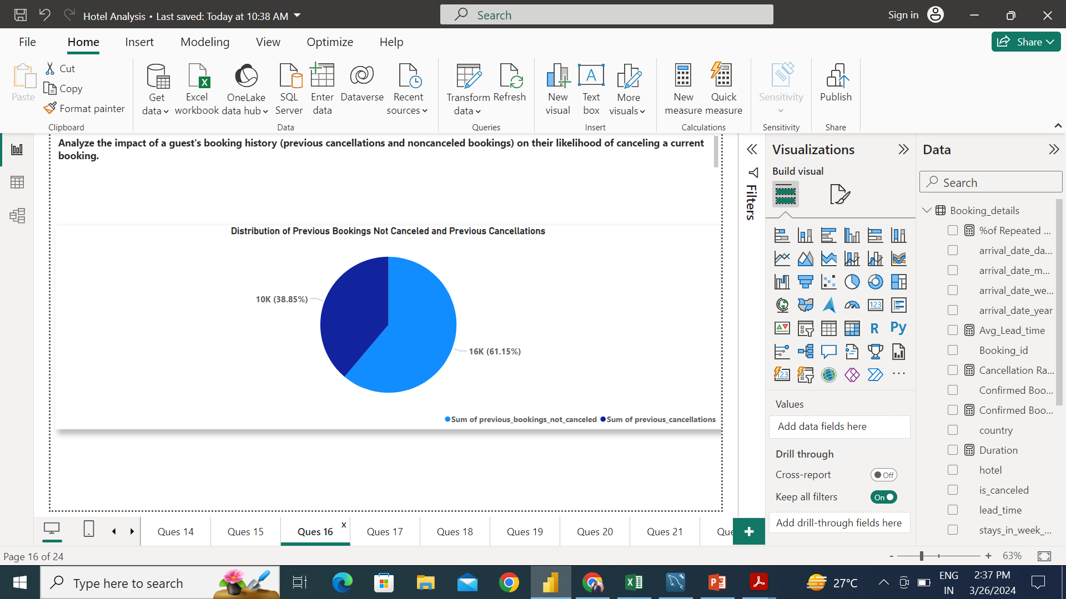

Slide 21
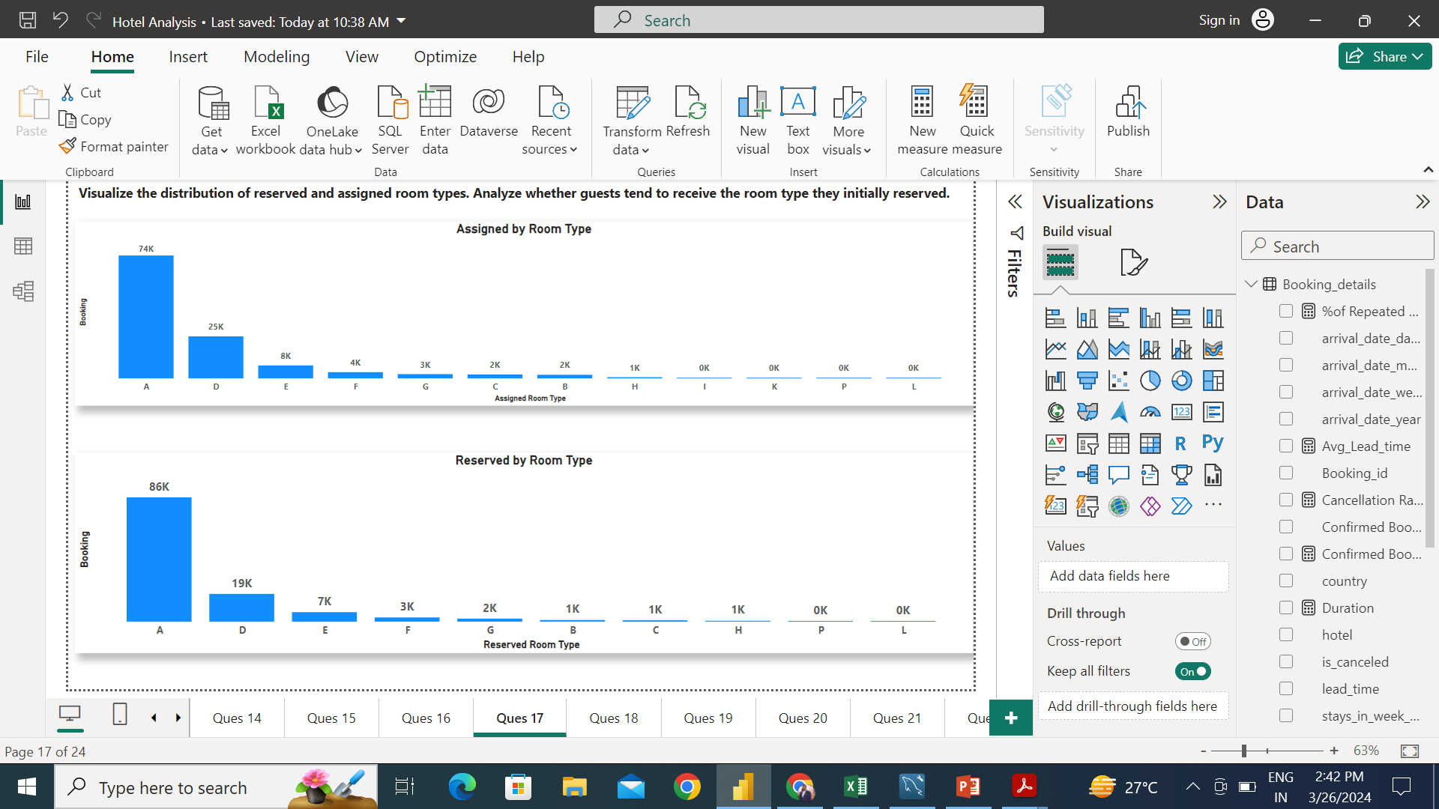
Room A has the maximum number of booking and assigned, but hotel failed to provide the same room type for all the guests.

Slide 22
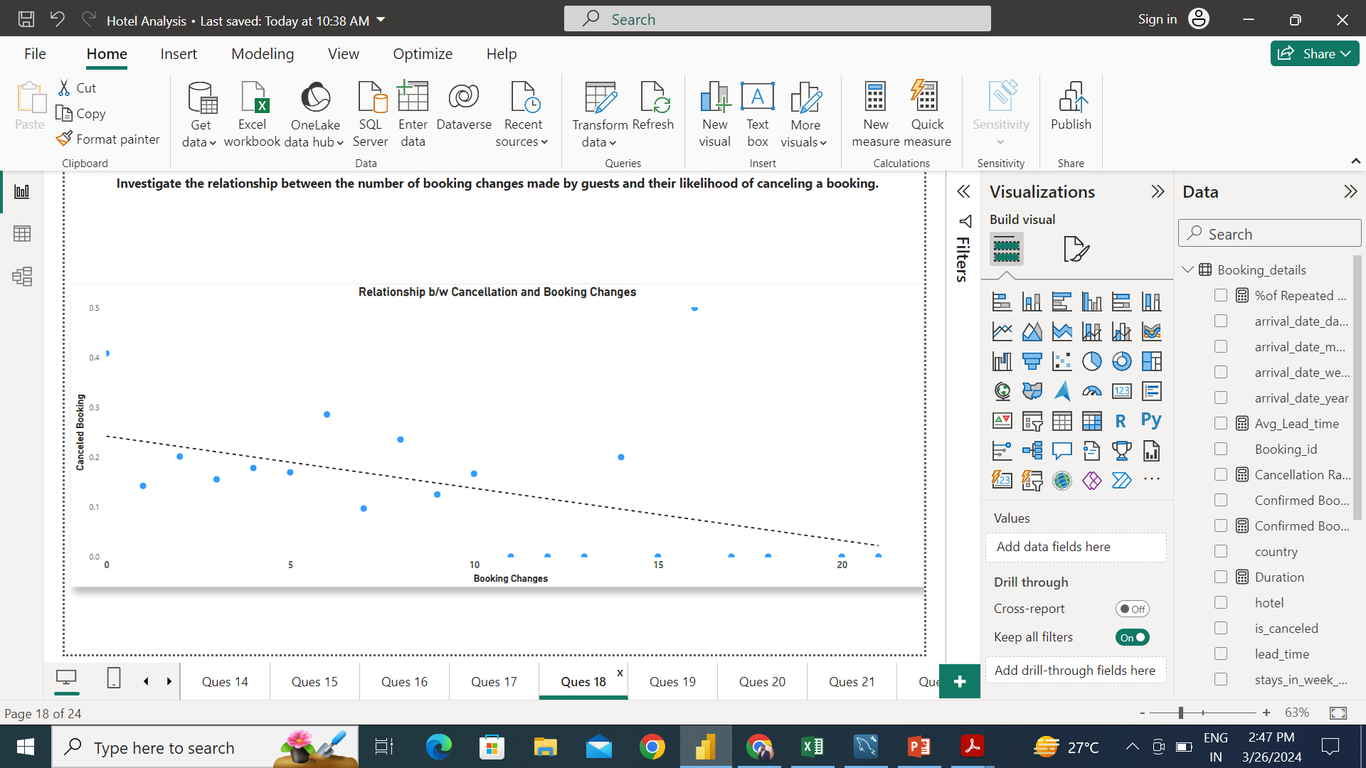
There is slightly negative correlation b/w booking changes and canceled booking. As the number of booking changes increases, cancellation descreases.

Slide 23
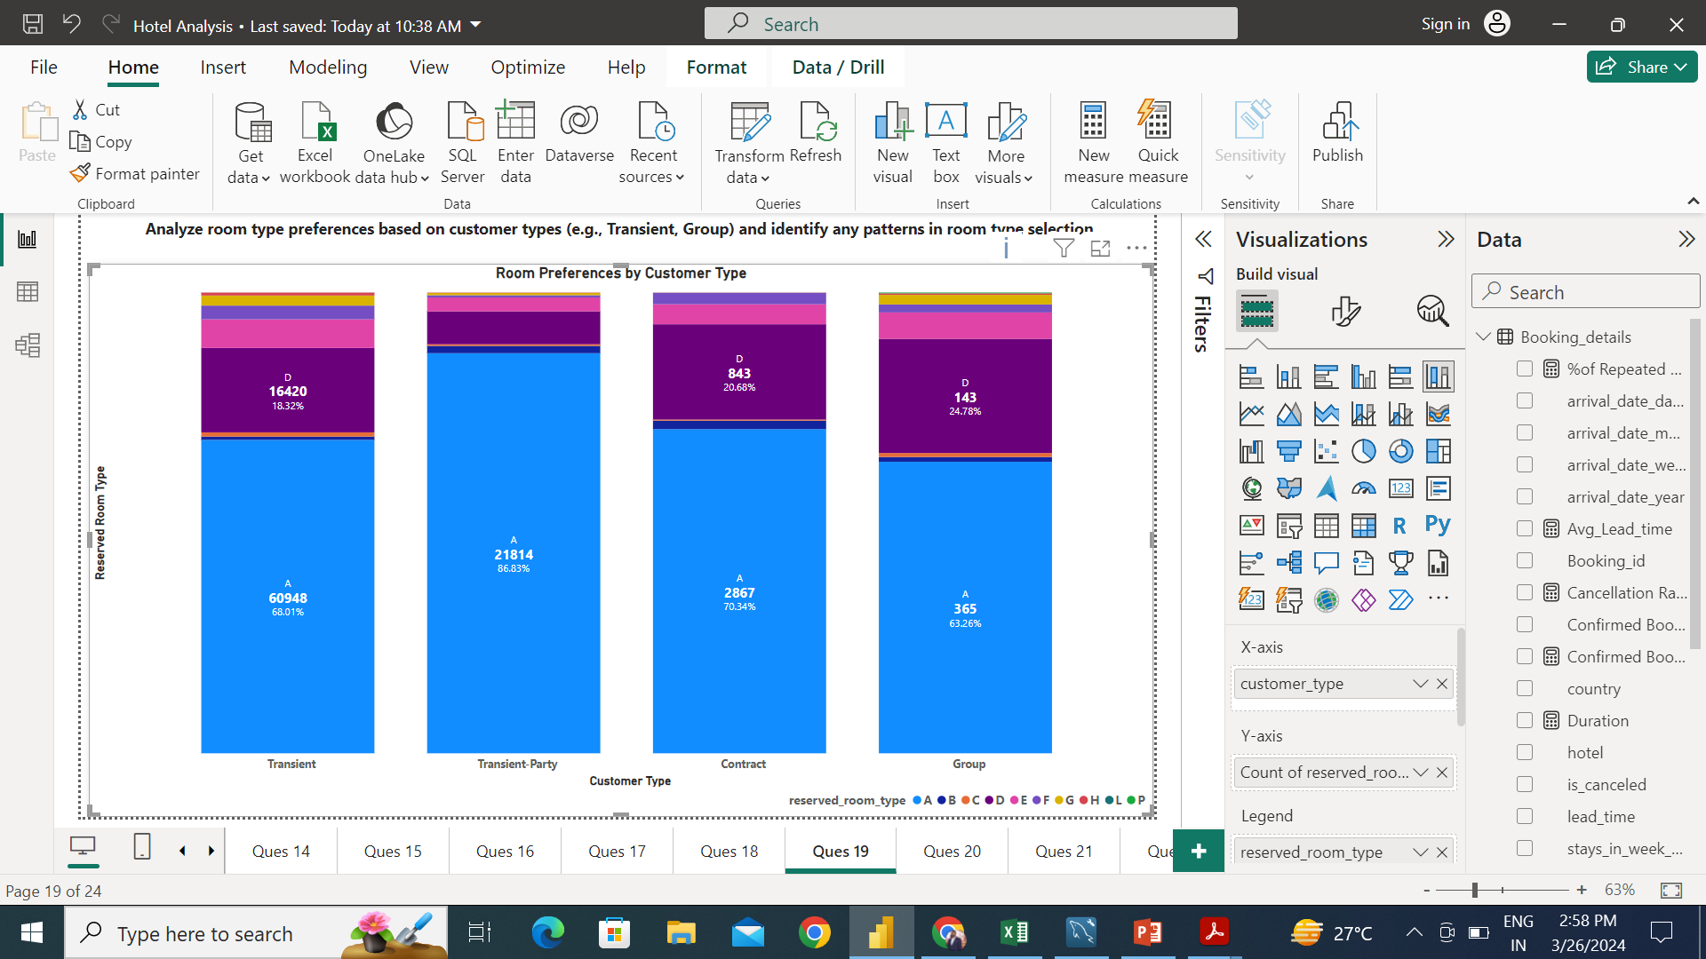
Room type A prefer by all the customer type. Transient-Party preferred Room type A most frequently among all customer type

Slide 24
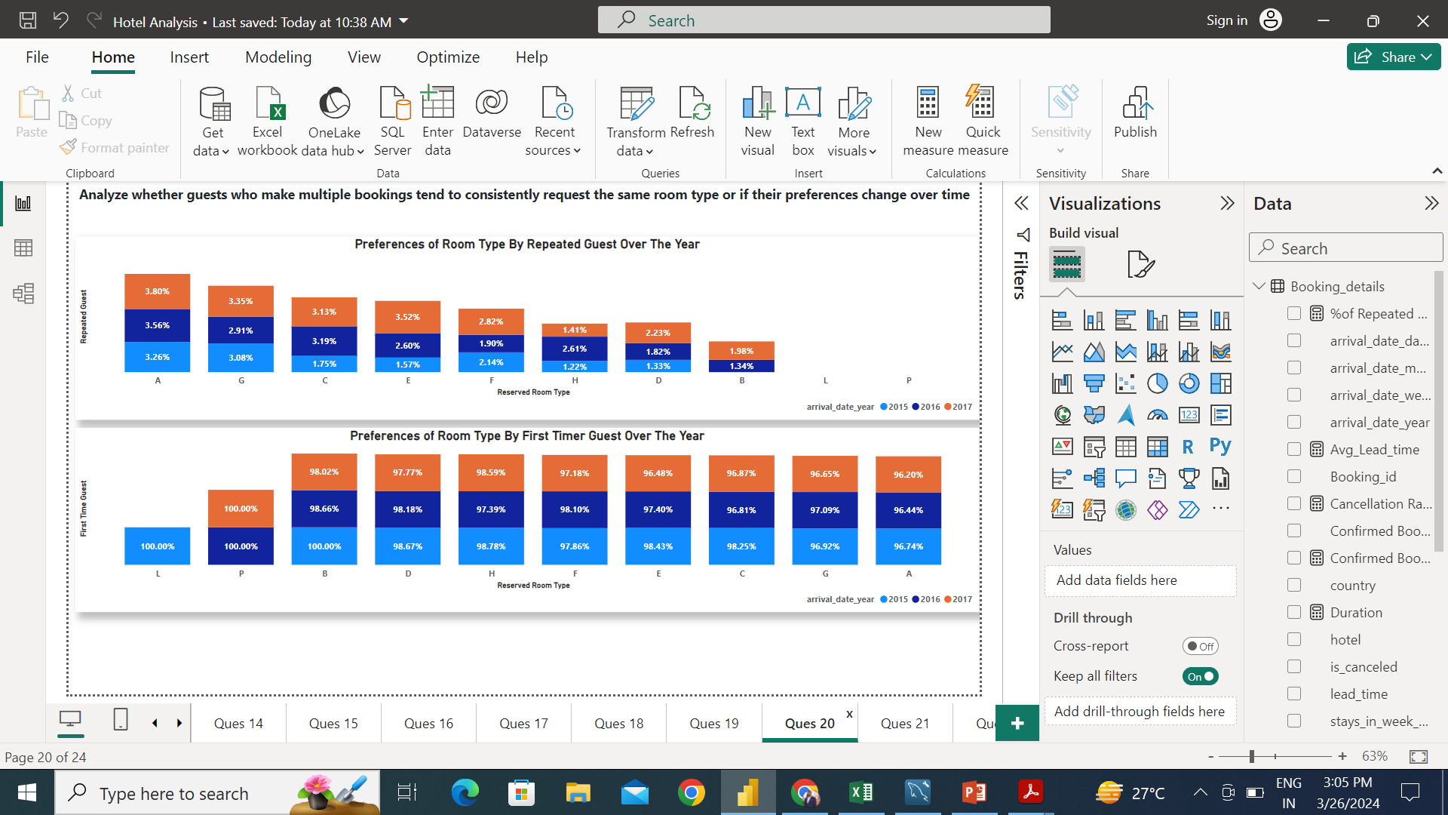
There is change in preference for room type of repeated guest over the years. In year 2015 no repeated selected room B, but in 2016, 1.34% of repeated guest select the same room.

Slide 25
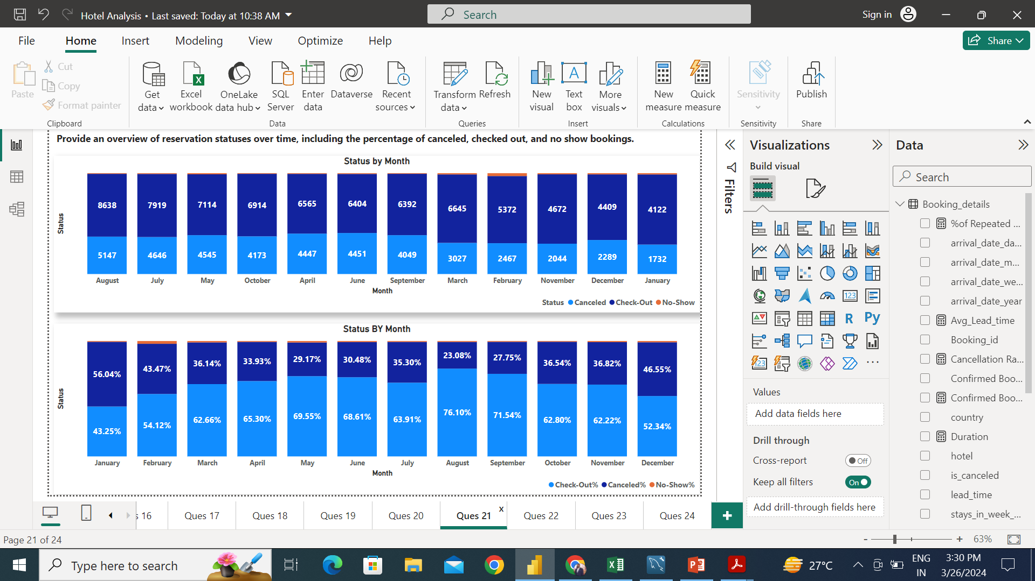
Most of the check-out happened in August with 76%, while January has most canceled with 56%.

Slide 26
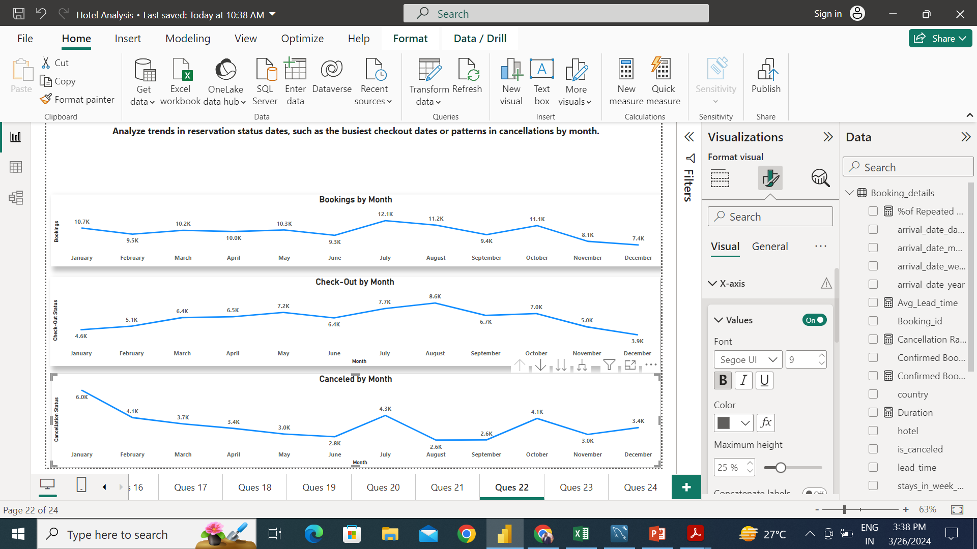
July has the maximum number of Bookings, while August has Maximum number of Check-outs and January has highest in term of cancellations.

Slide 27
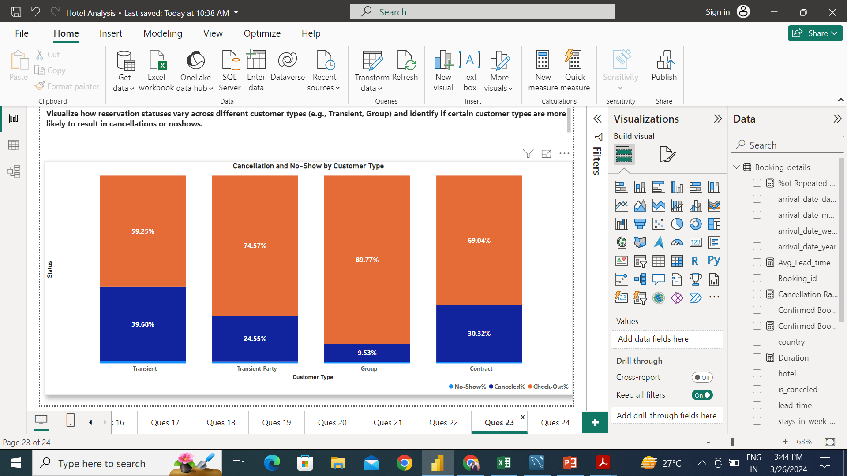
Transient customer type contributed most by 39.68% in canceled.

Slide 28
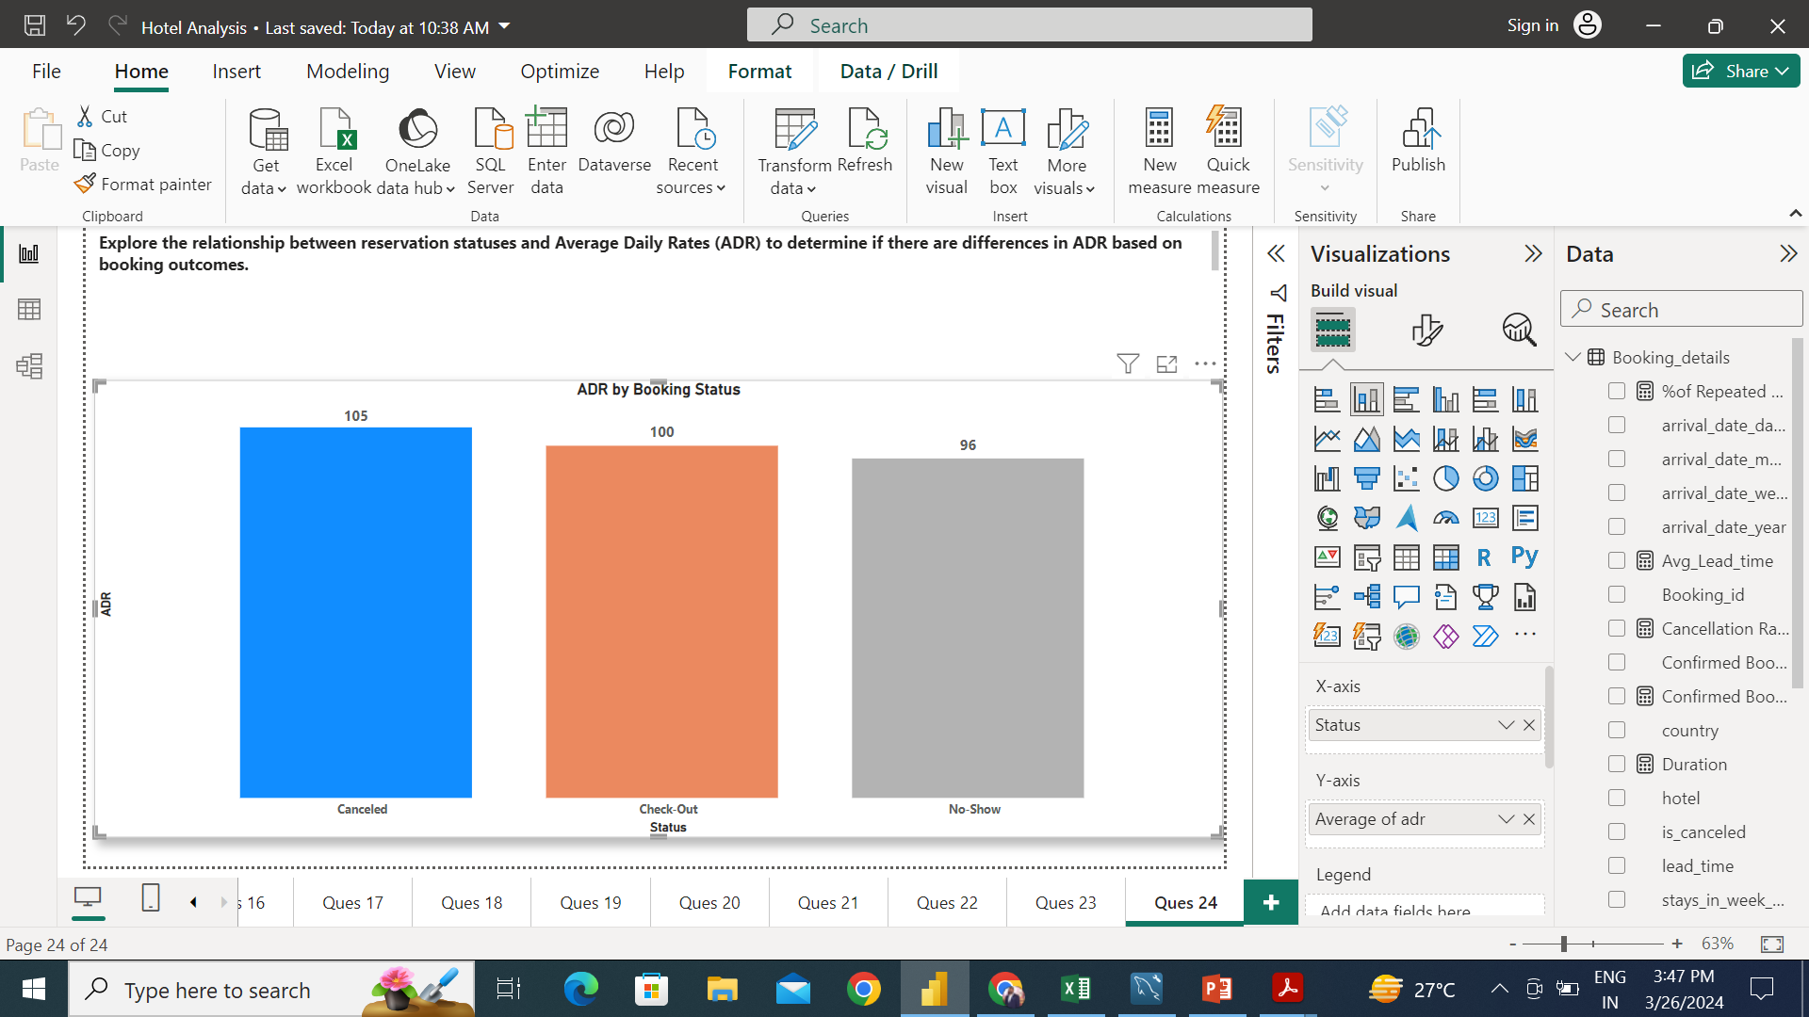
Canceled reservation type has the maximum ADR while No-Show has the lowest.

Slide 29
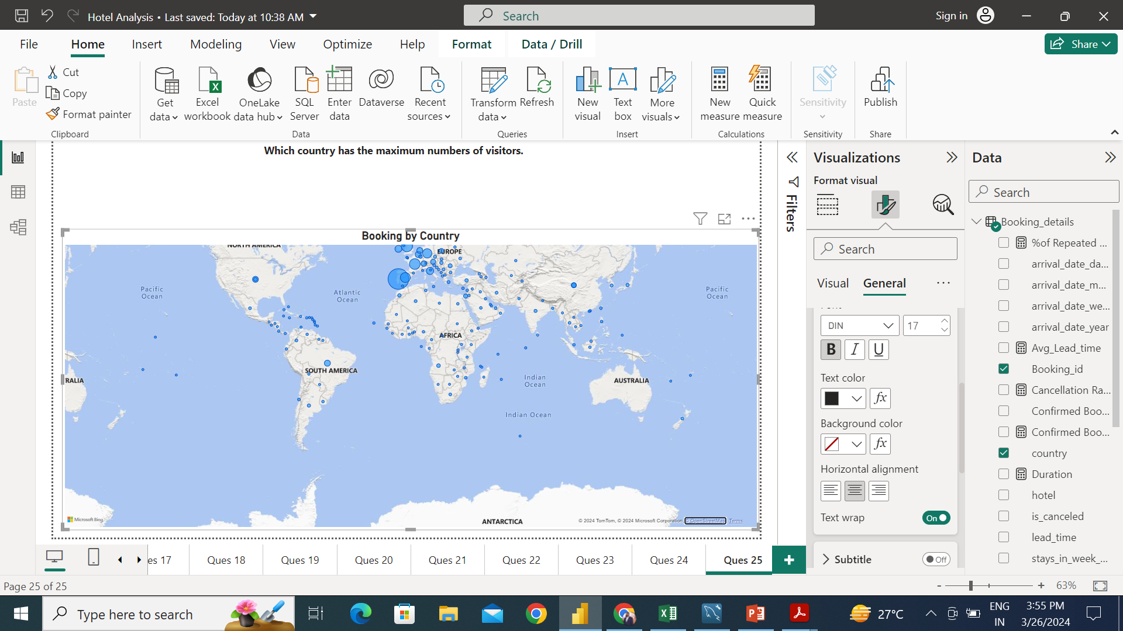
Portugal has the maximum number of visitors

Slide 30
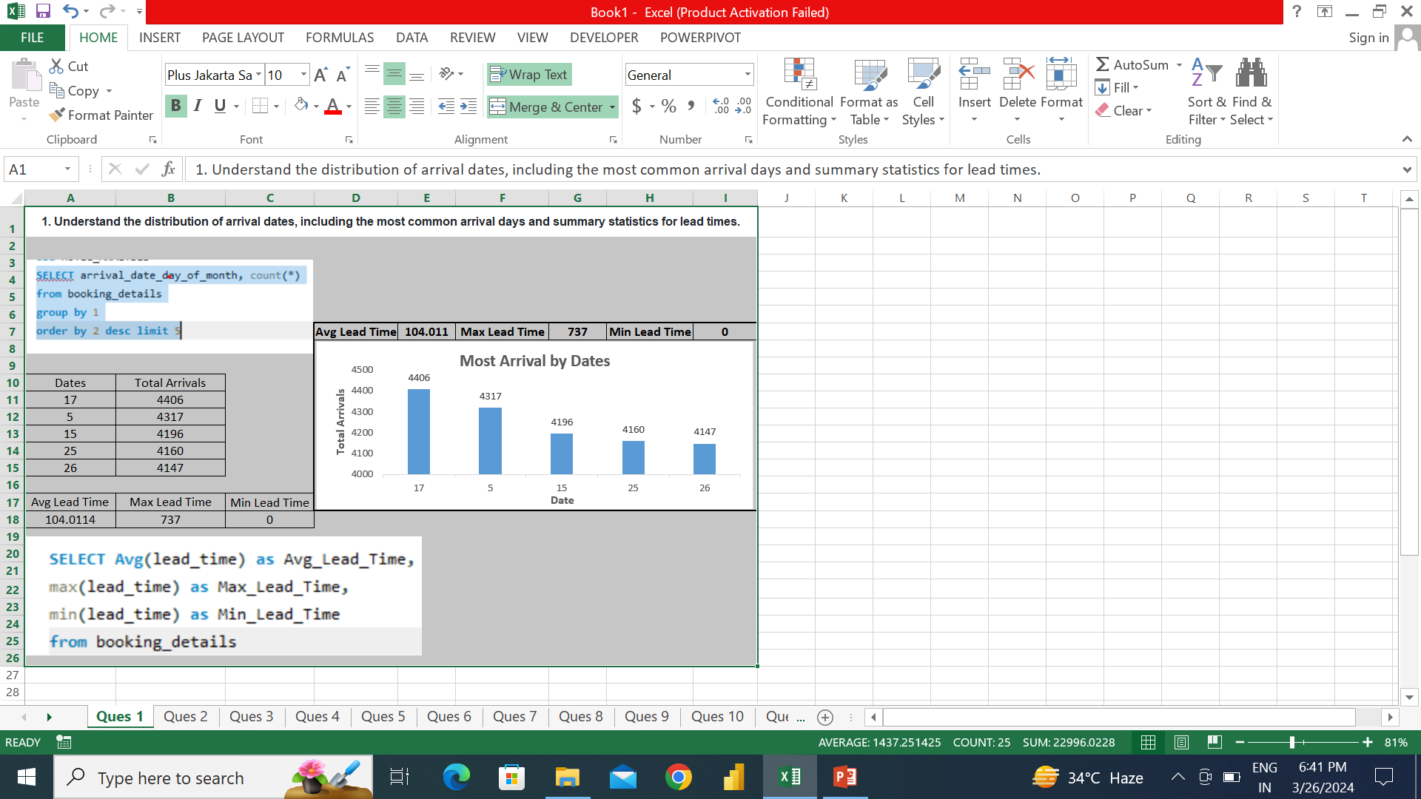
Second half in the month have the most bookings, and Avg Lead Time 104,Max lead time 737.

Slide 31
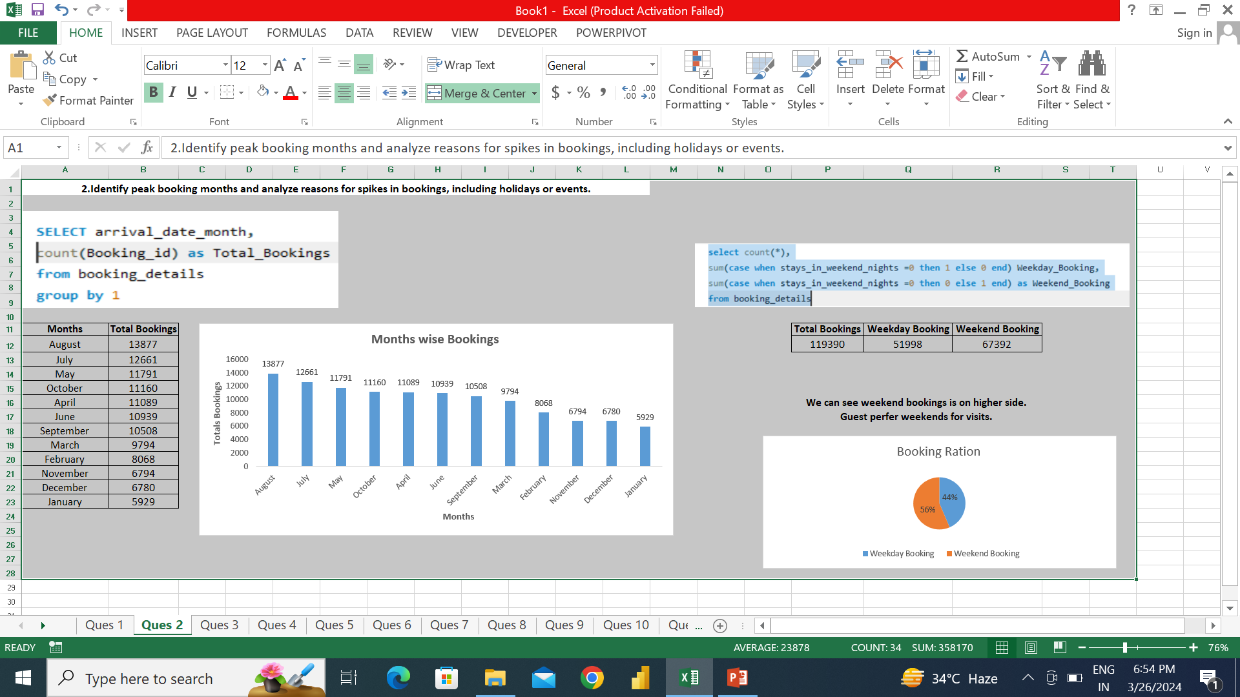
August is the peak month for booking and 56% booking comes in weekend.

Slide 32
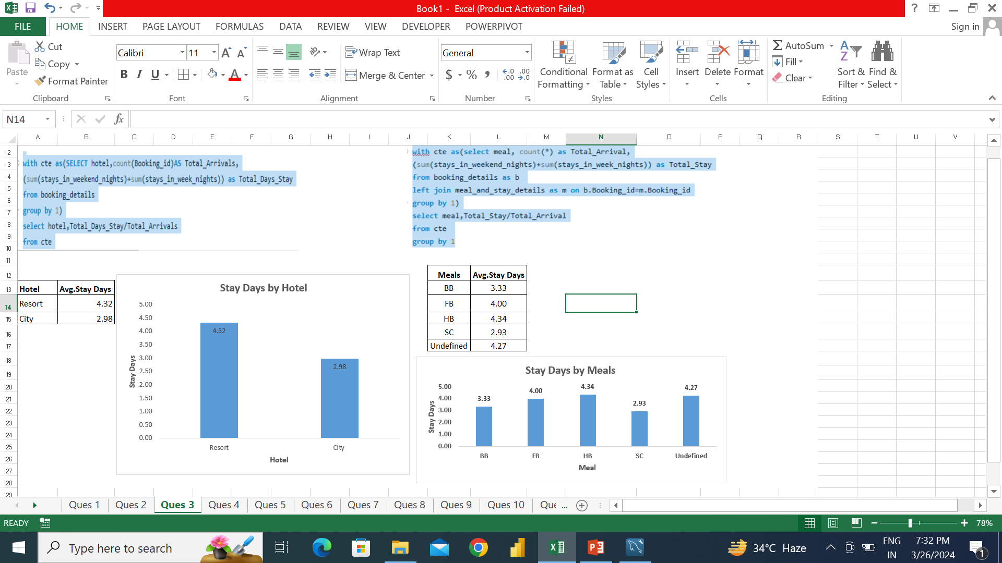
Resort have the Better avg stay rate while HB meal type has topped in avg stay rate among meal type.

Slide 33
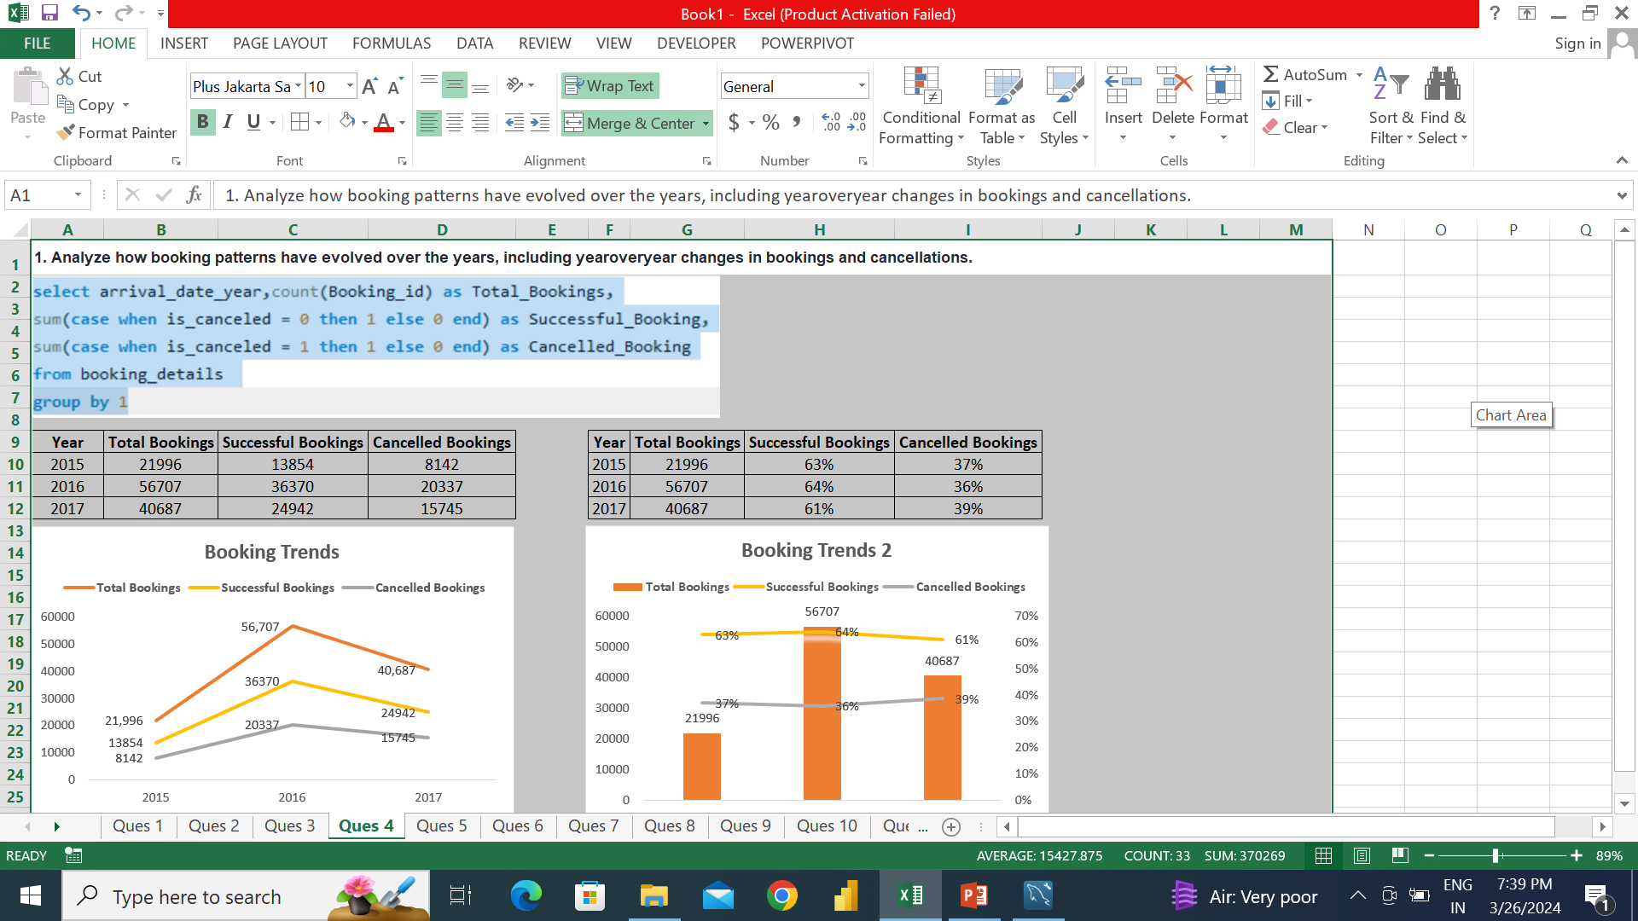
Successful booking ratio declined over the years while cancelled booking ratio increased.

Slide 34
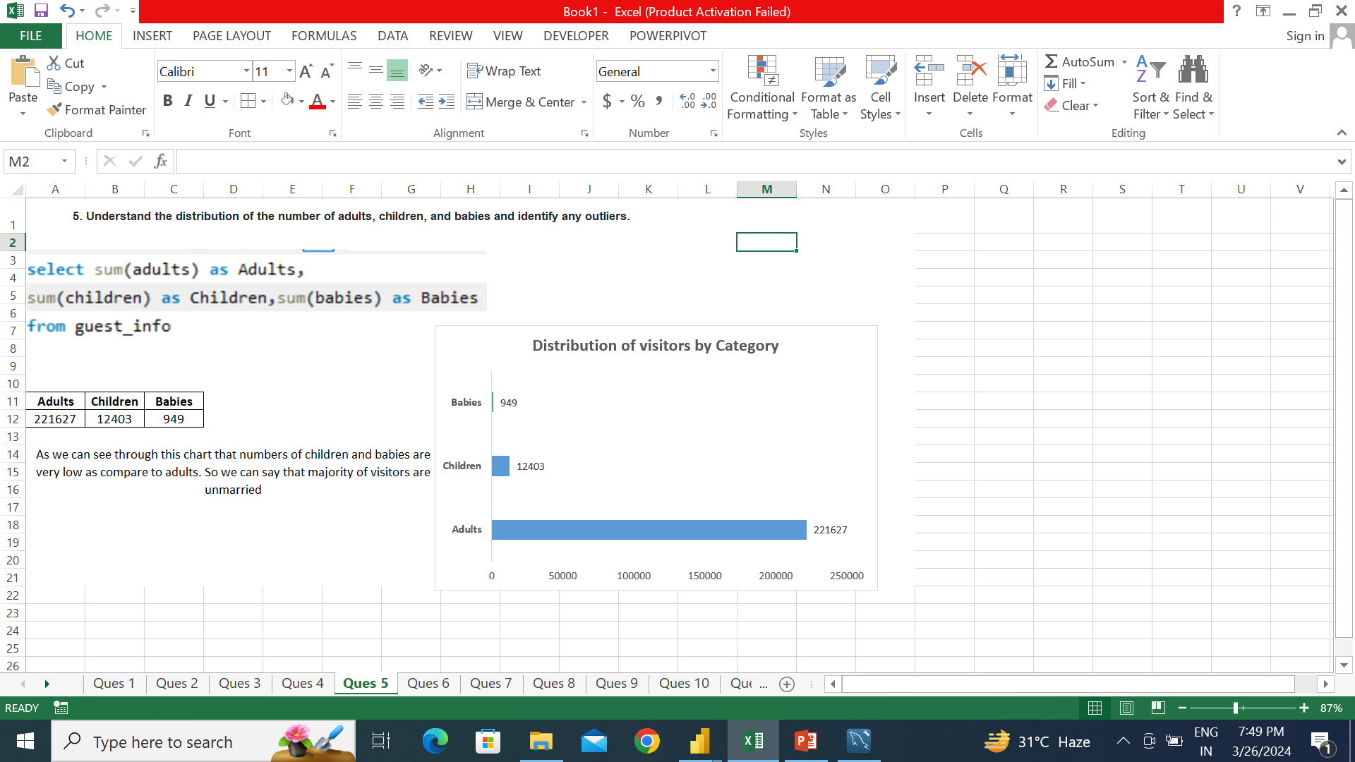
Majority visitors are adults. There are less number of children and kids, so we can say majority of visitors are unmarried and don’t have kids.

Slide 35
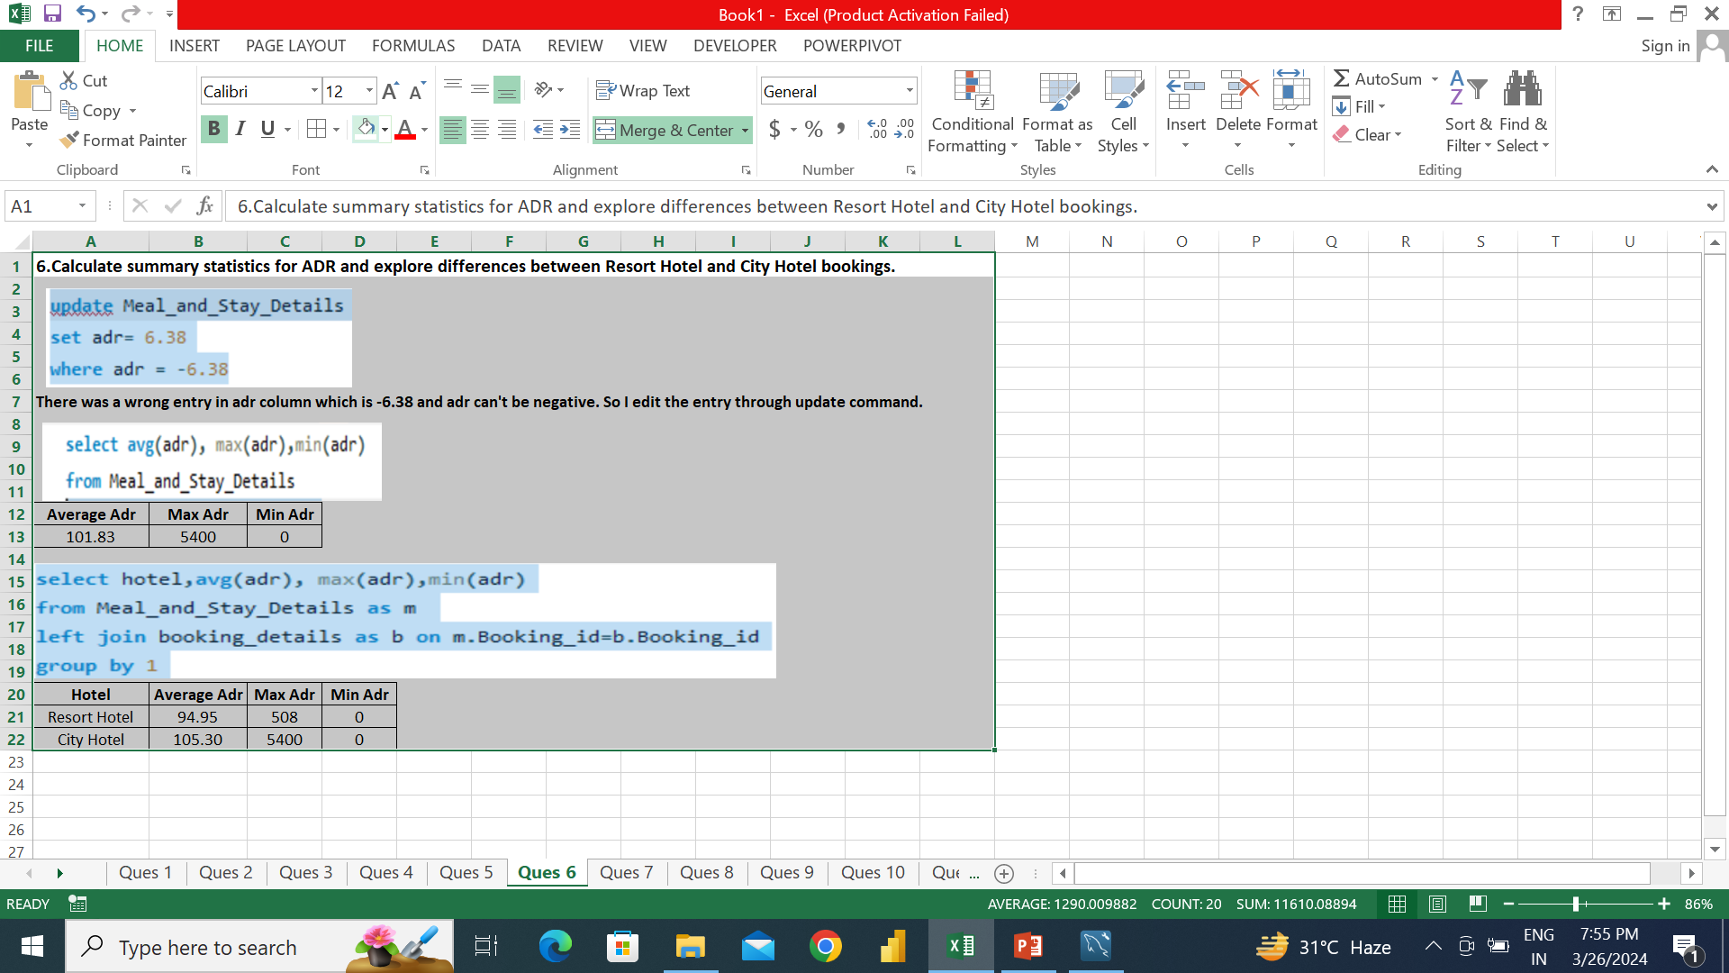
City hotel is expensive then Resort hotel. There is huge difference in max ADR b/w Resort and City hotel.

Slide 36
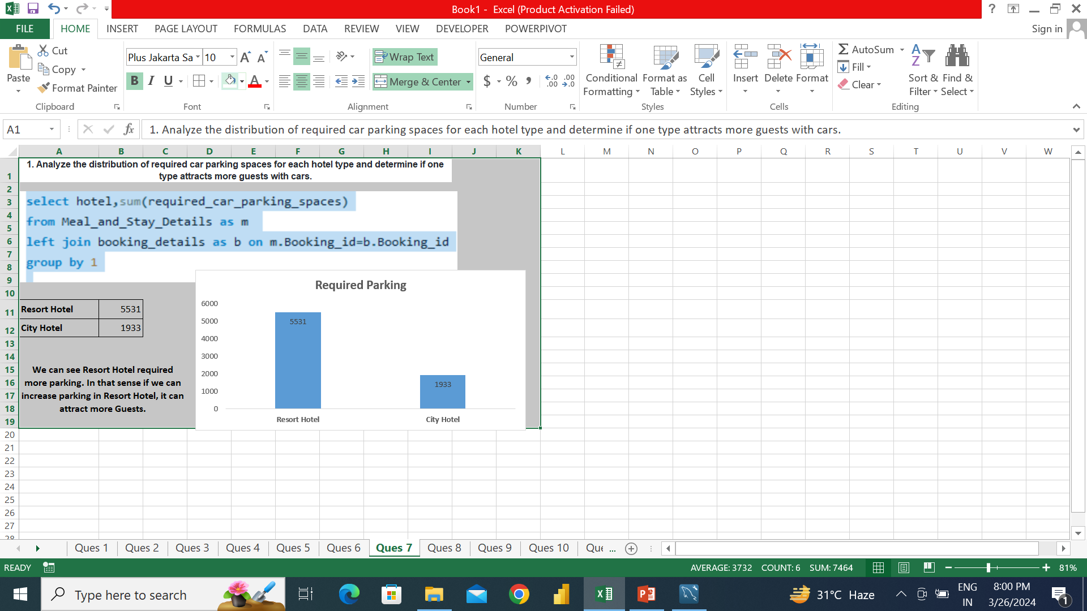
There is huge difference for car parking spaces required b/w Resort(5531) and City(1933). Increase in car parking spaces specially in Resort can attract some visitors.

Slide 37
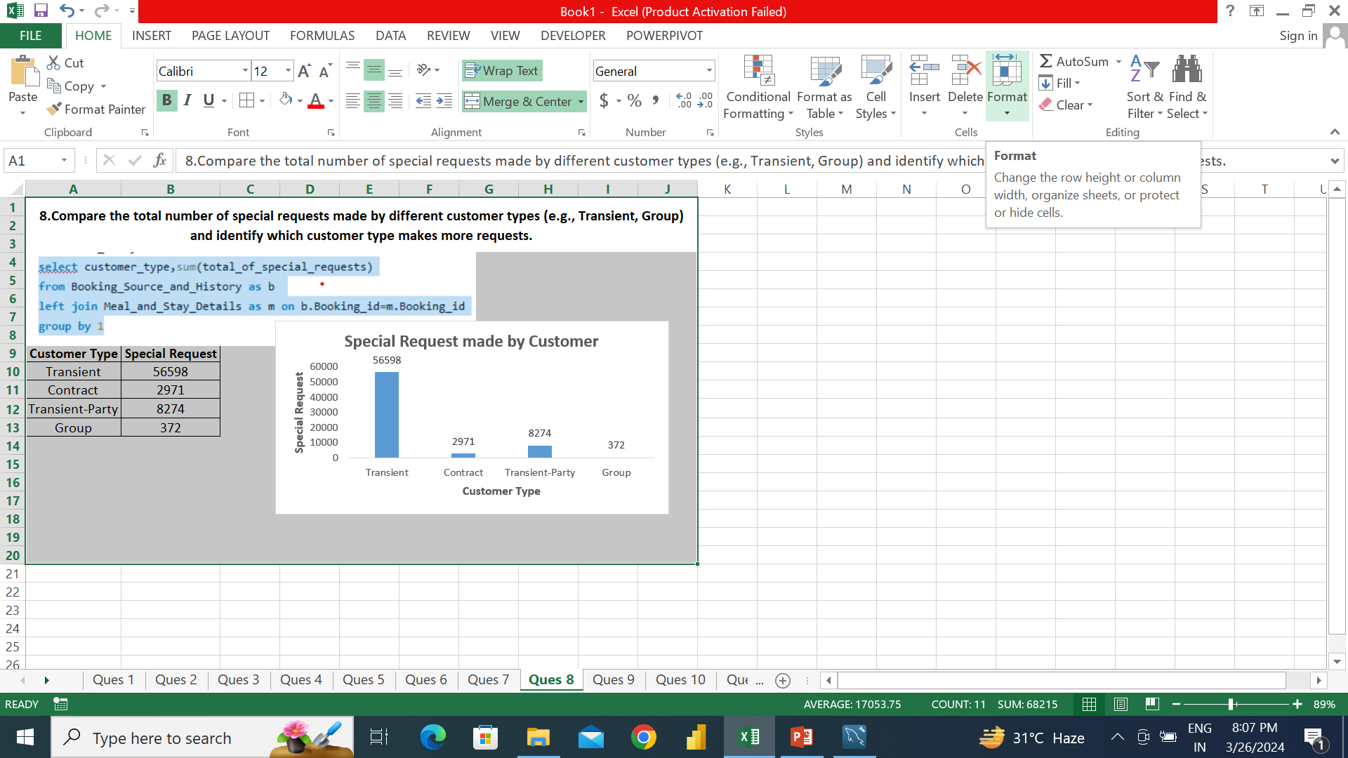
Transient customer type made most of the special request by huge difference.

Slide 38
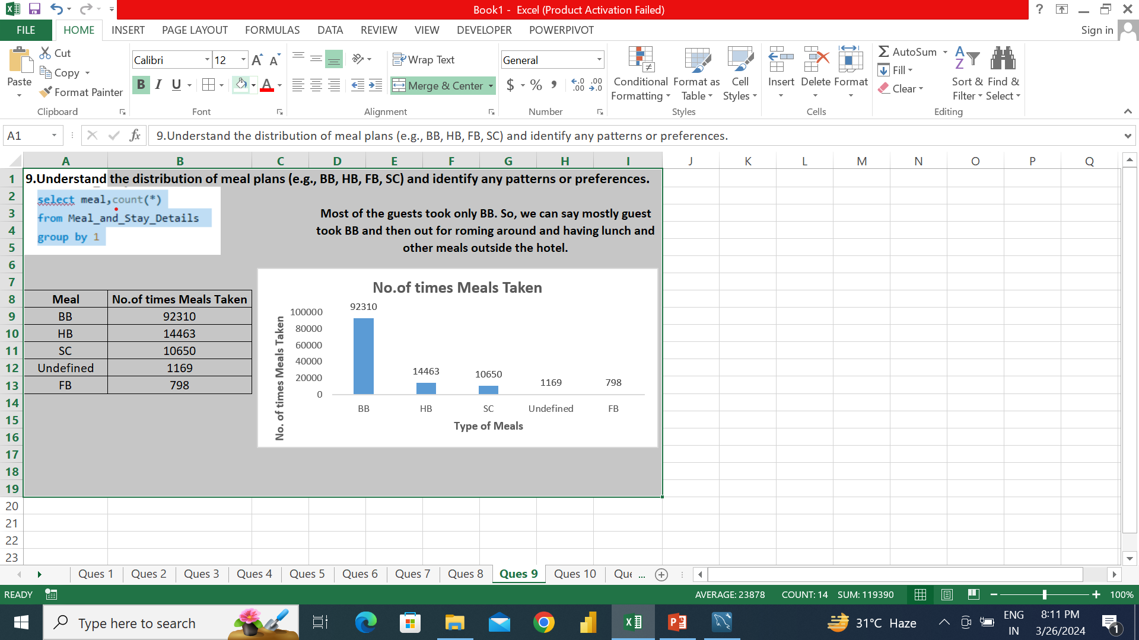
Most of the visitors prefer BB then go out for roaming and take other meals outside hotel.

Slide 39
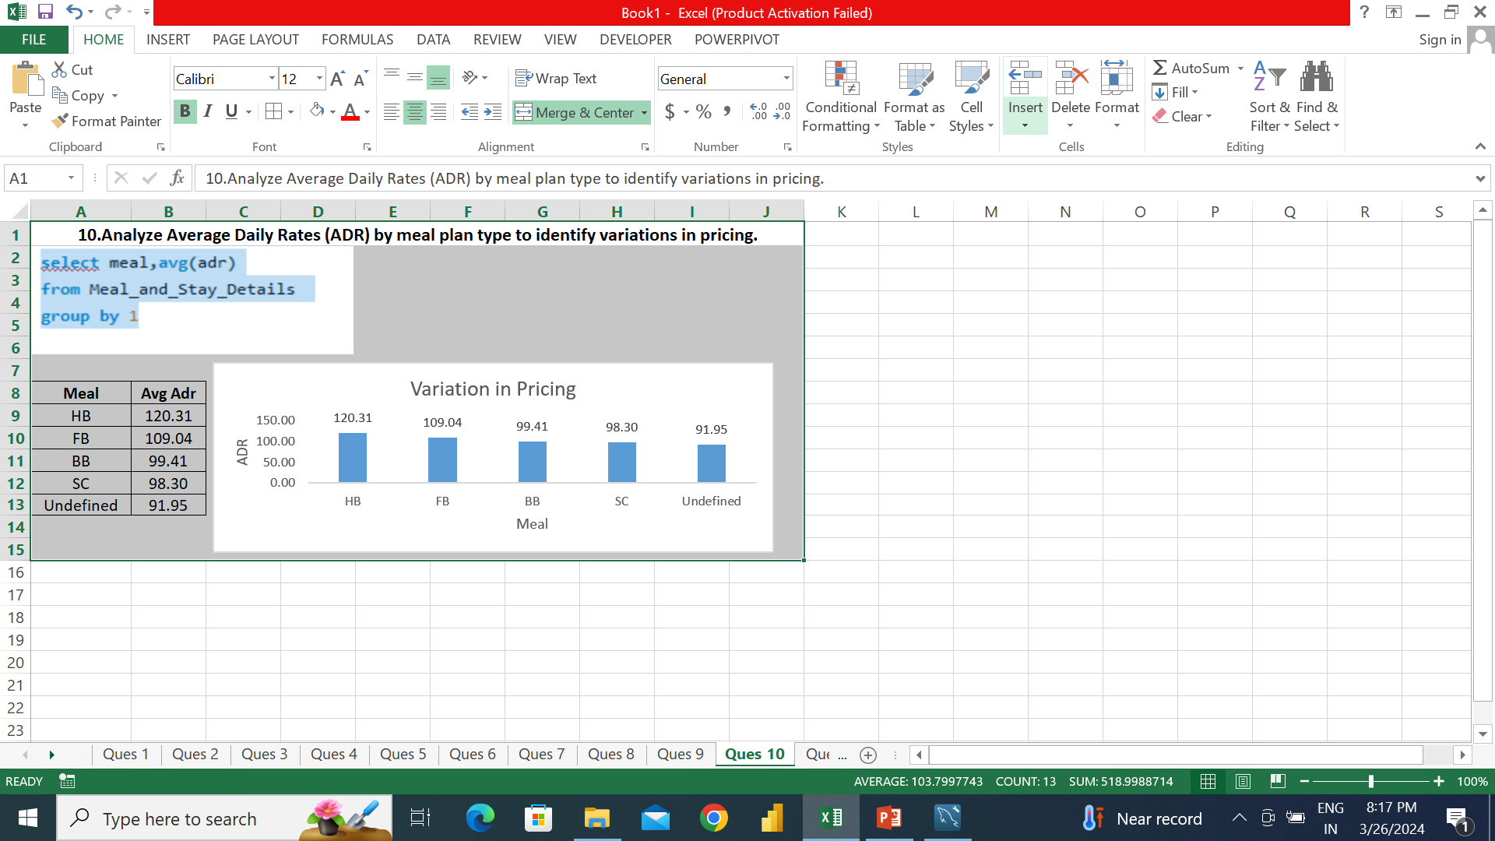
HB meal type has the maximum ADR.

Slide 40
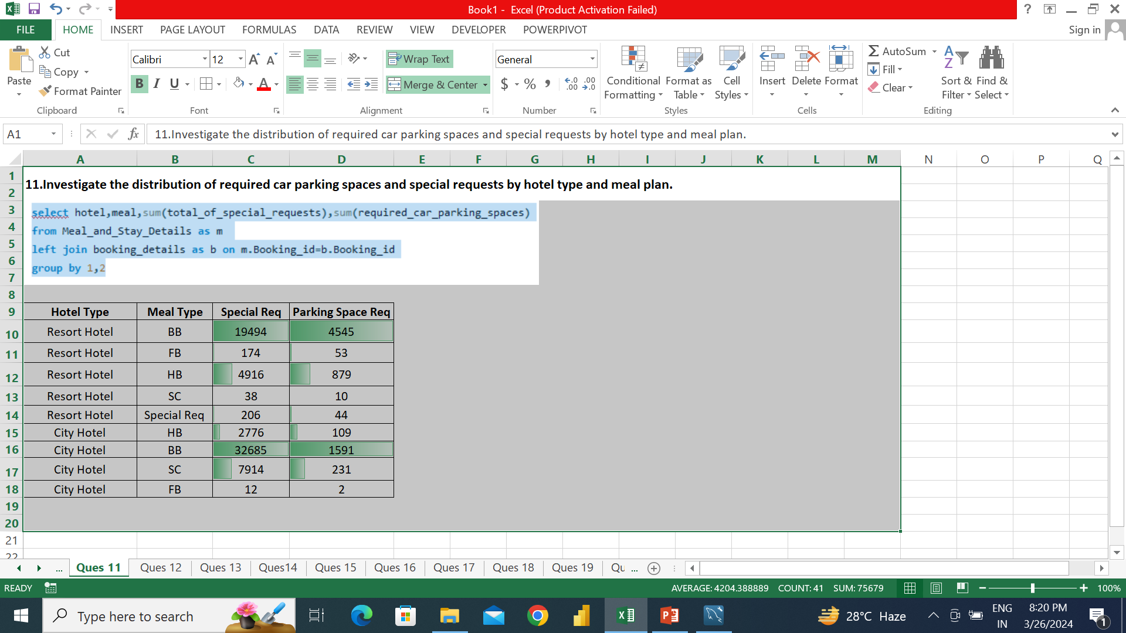
Resort hotel with BB meal has the most special requests and required most car parking spaces. We can say BB meal time is most crowed time during whole day.

Slide 41
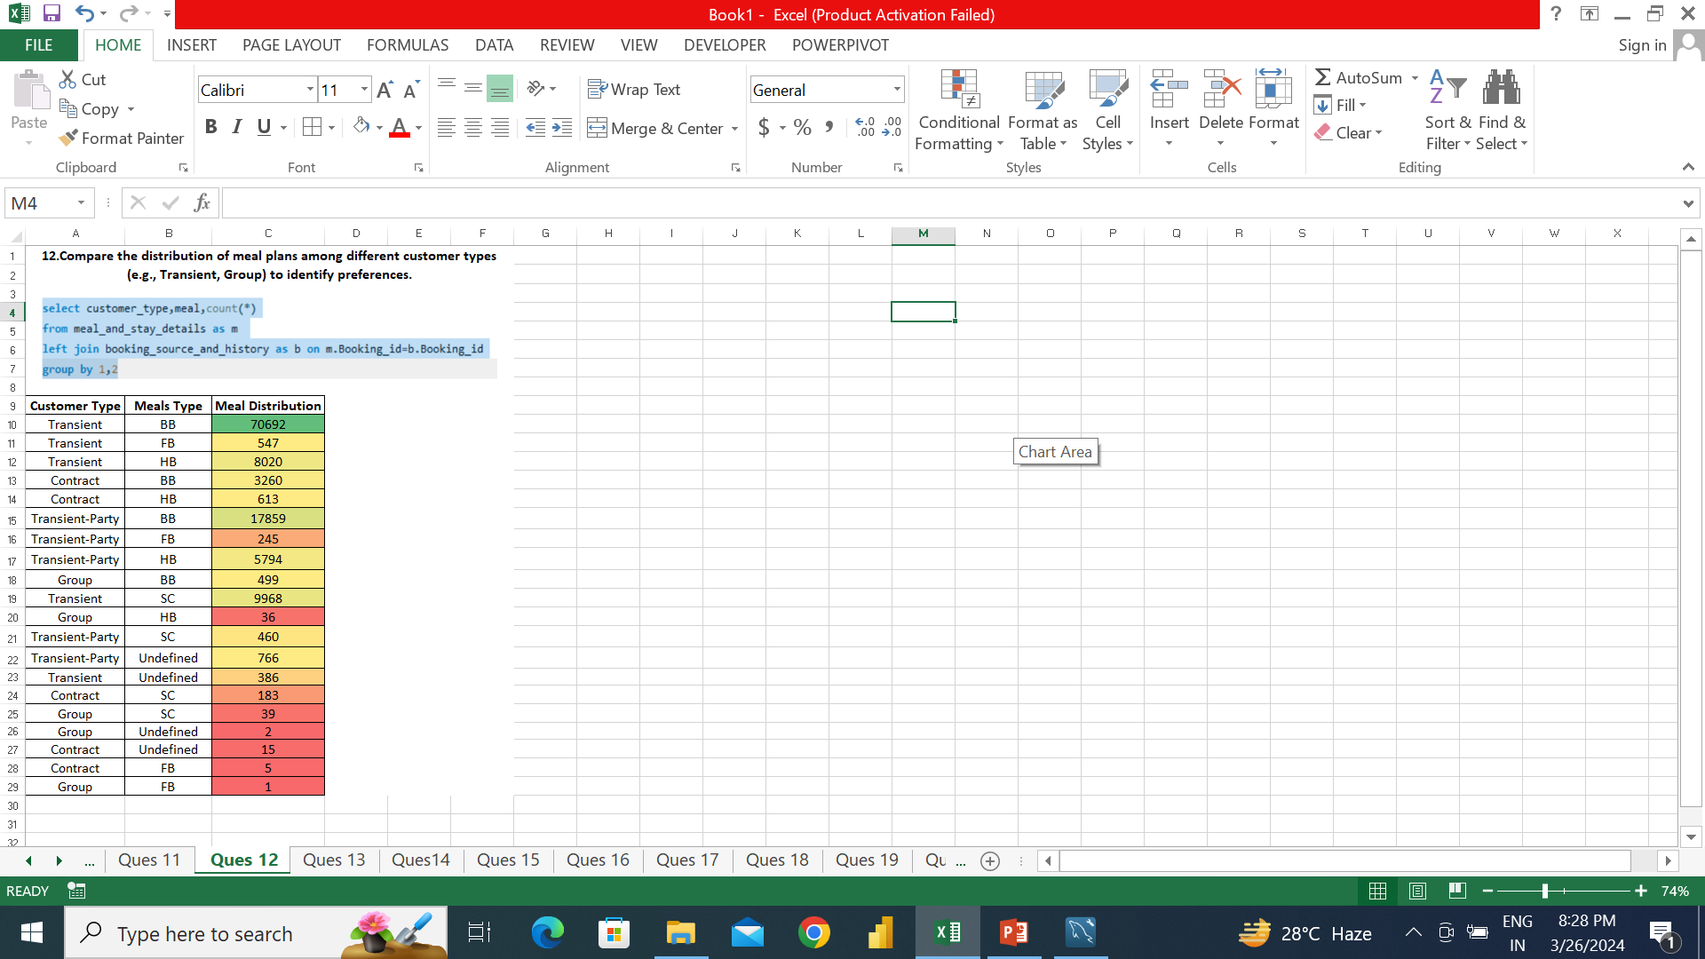
Transient customer type with BB has most number while Group customer type with FB has lowest number.

Slide 42
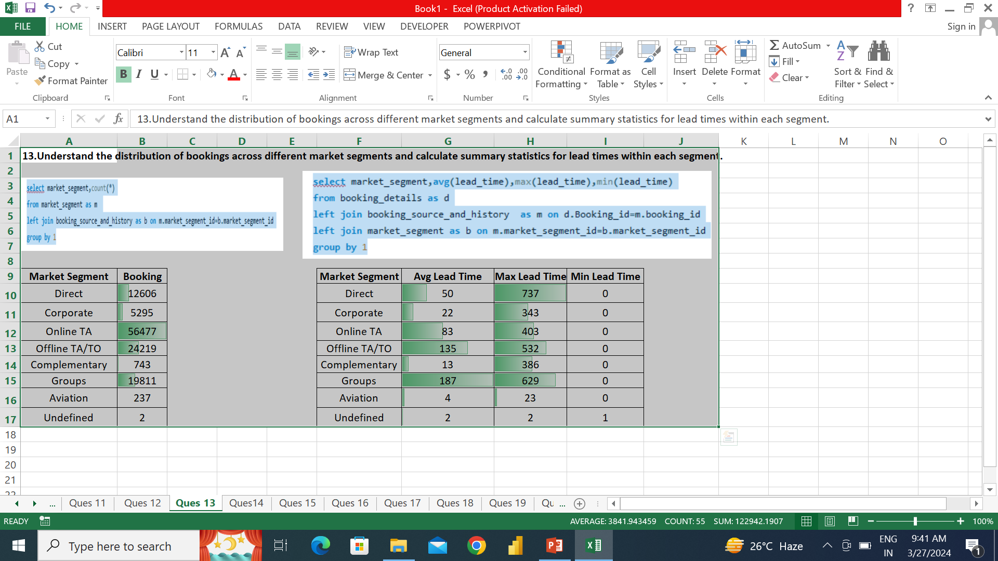
Online TA has the biggest market share of Bookings.

Slide 43
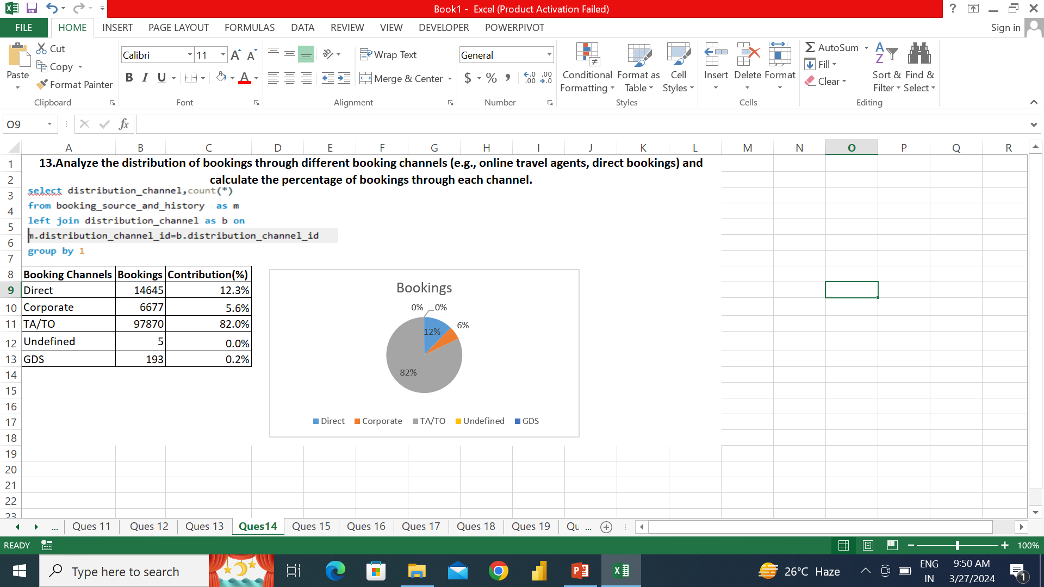
TA/TO has the biggest market player with 82% market share, followed by Direct with 12.3% with huge difference b/w 1st and 2nd player.

Slide 44
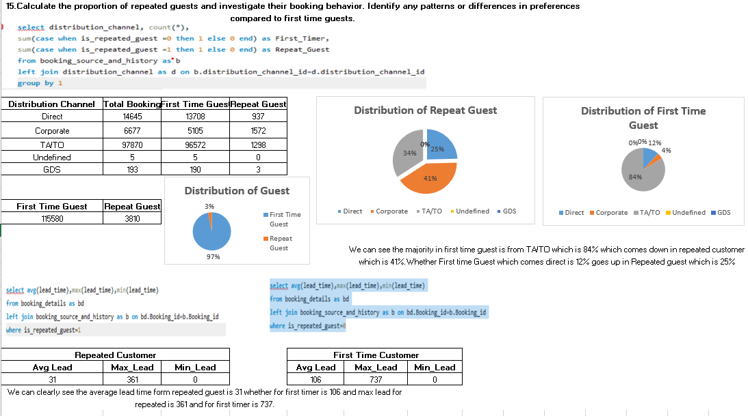

Slide 45
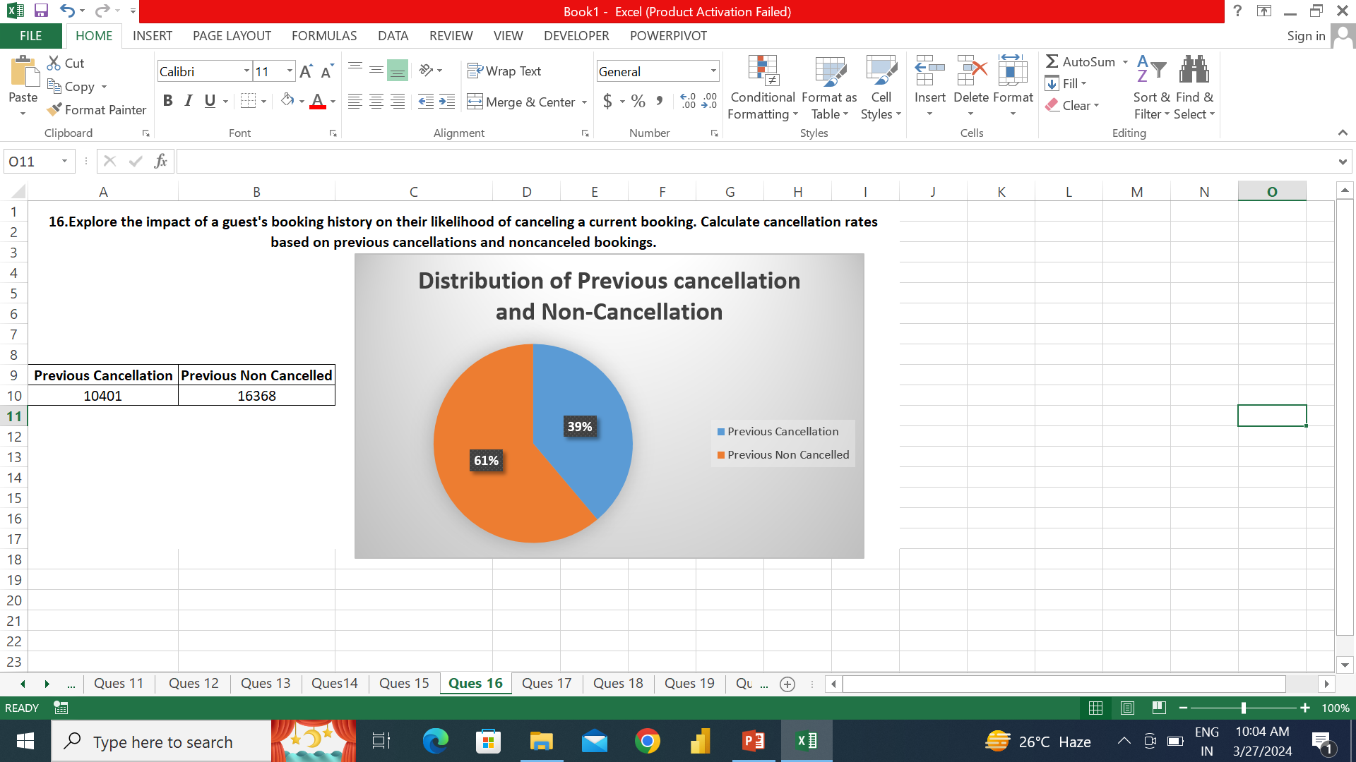

Slide 46
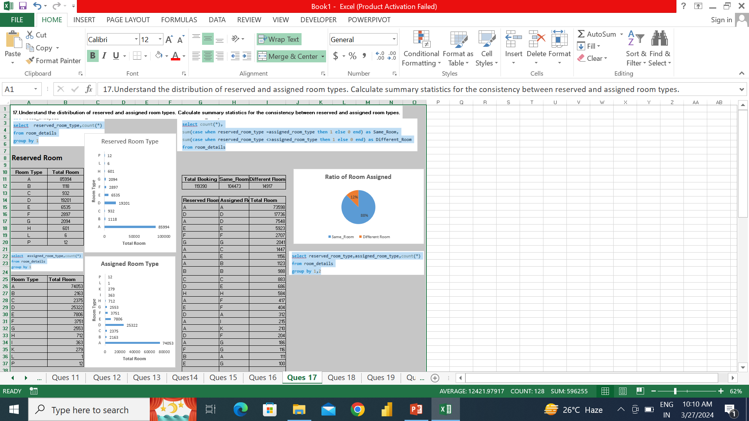
For 88% visitors hotel are capable to delivered the same room they reserved.

Slide 47
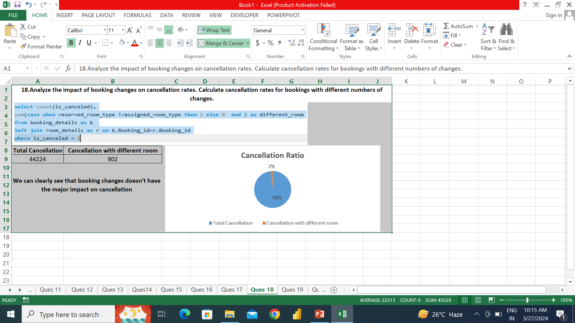
Just 2% is the cancellation rate when the guest assigned different room from what they reserved. So, different room not put any impact on cancellations.

Slide 48
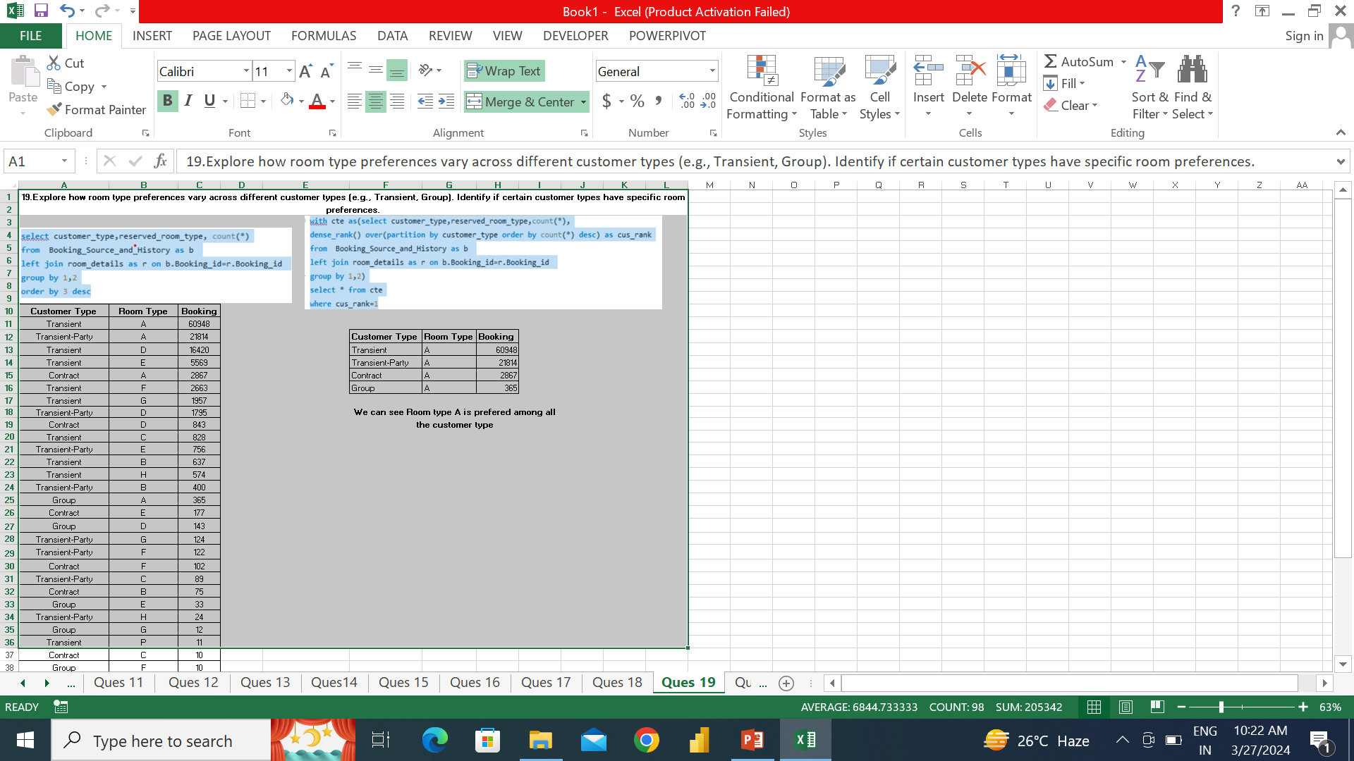

Slide 49
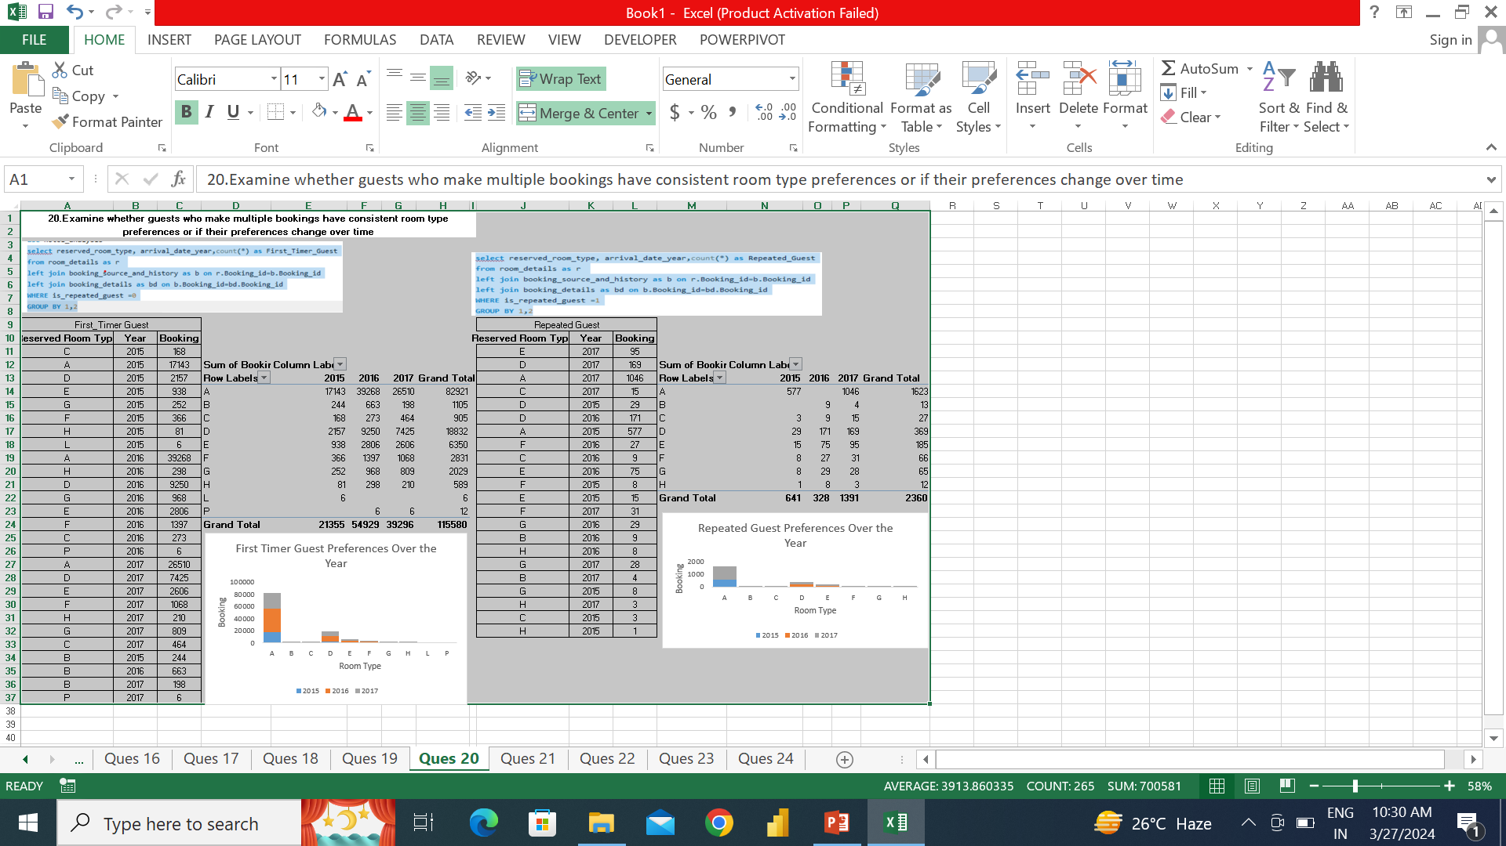
For repeated guest’s preference changes over the year, we can see in 2015 many people reserved room type A but in 2016 there is not booking for repeated guest form room type a

Slide 50
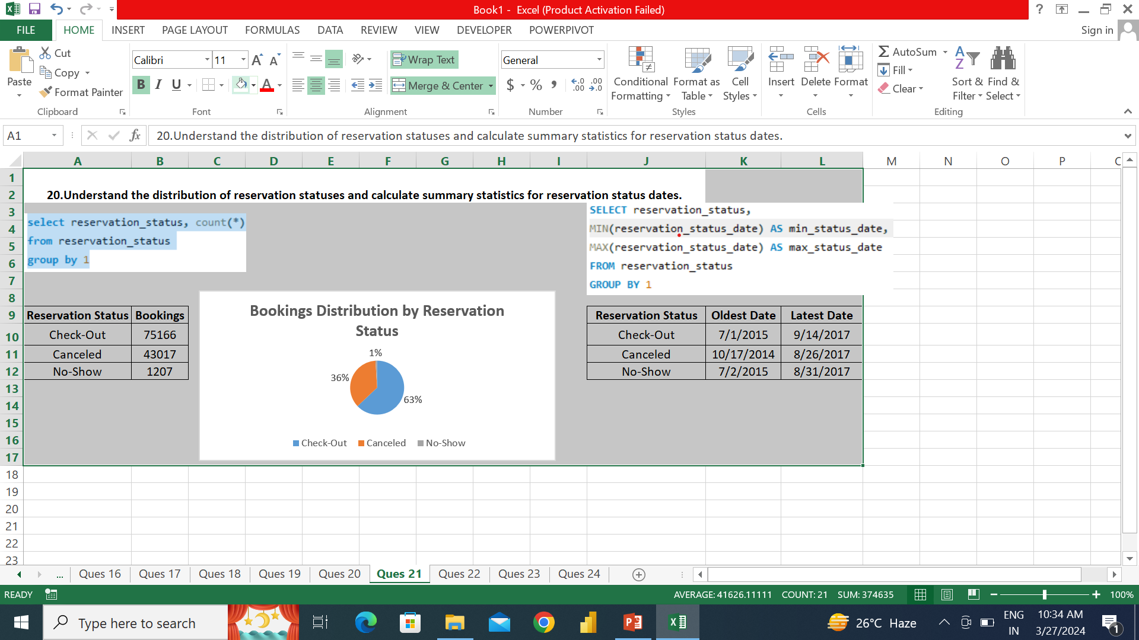
First check-out was on 7-1-15 and ratio is 63%, while cancellation ratio is 235

Slide 51
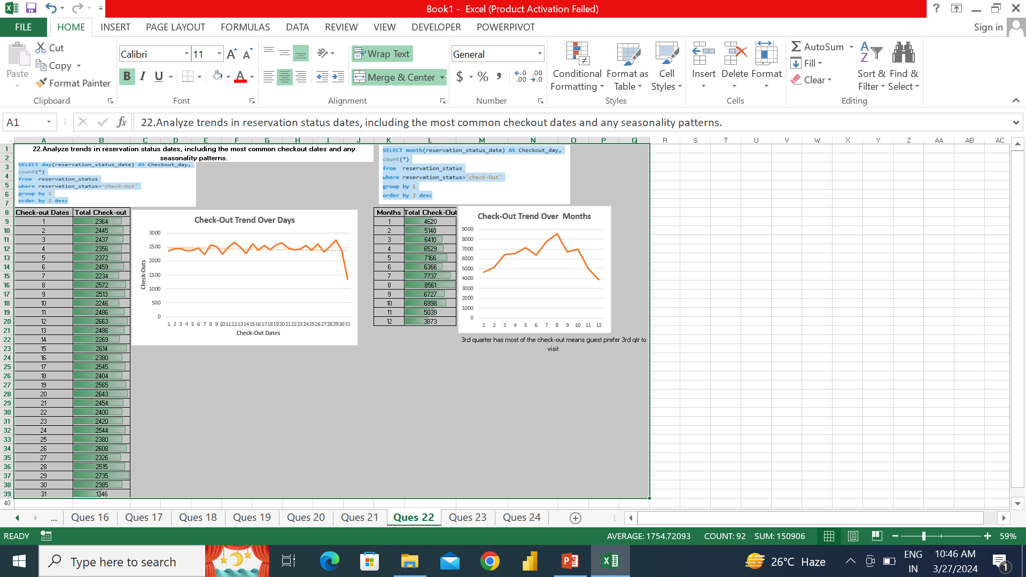
July, August and September are the best months for in term of visits. Guest prefer 3rd quarter and 2nd half of month for visit.

Slide 52
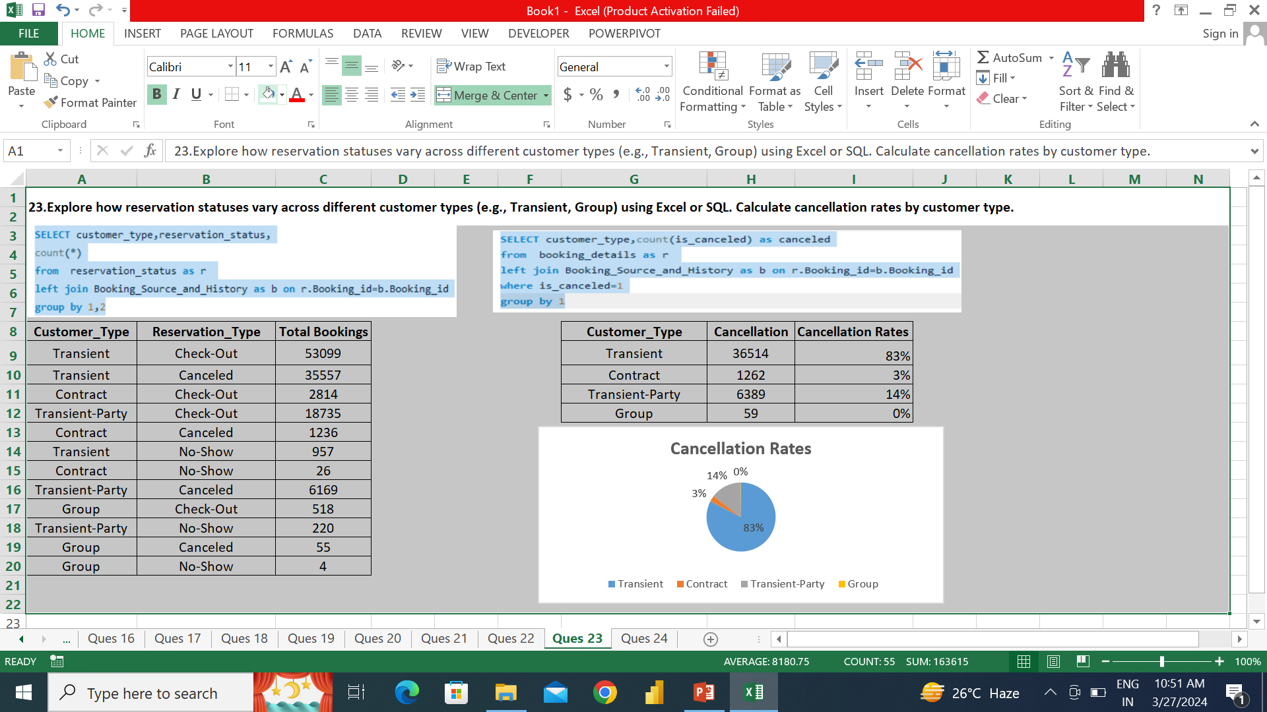
Transient topped with cancellation rate 83%

Slide 53

Cancellation has more avg ADR than check-out. Hotels getting some percentage on cancellation booking too

Slide 54
Thank You

